Slide 1
Life Outside the Classroom: General Resources
June Orientation
2020

Slide 2
Panelist
Will Johnson, PhD, dean of students (moderator)
Jon Carroll, chief information officer
Jim Fitzpatrick, assistant vice president,
Kamala Kiem, associate dean and director, Student Engagement
Pejay Lucky, director, Student Diversity and Multicultural Affairs
Eli Olken-Dann, director, Recreation
Meredith Smith, associate director, Residence Life

Slide 3
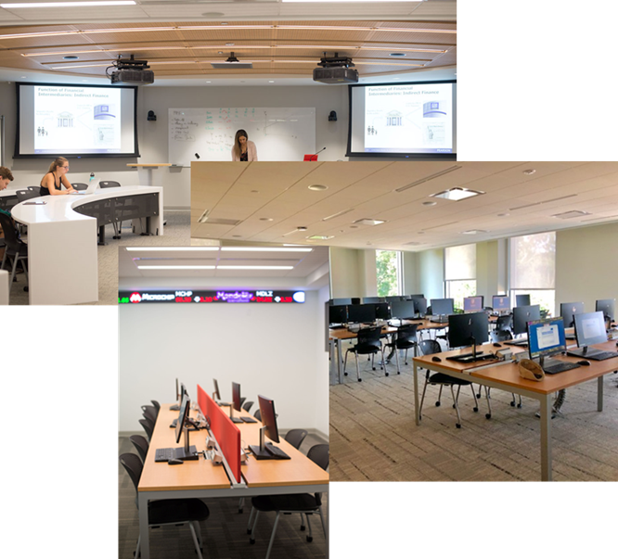
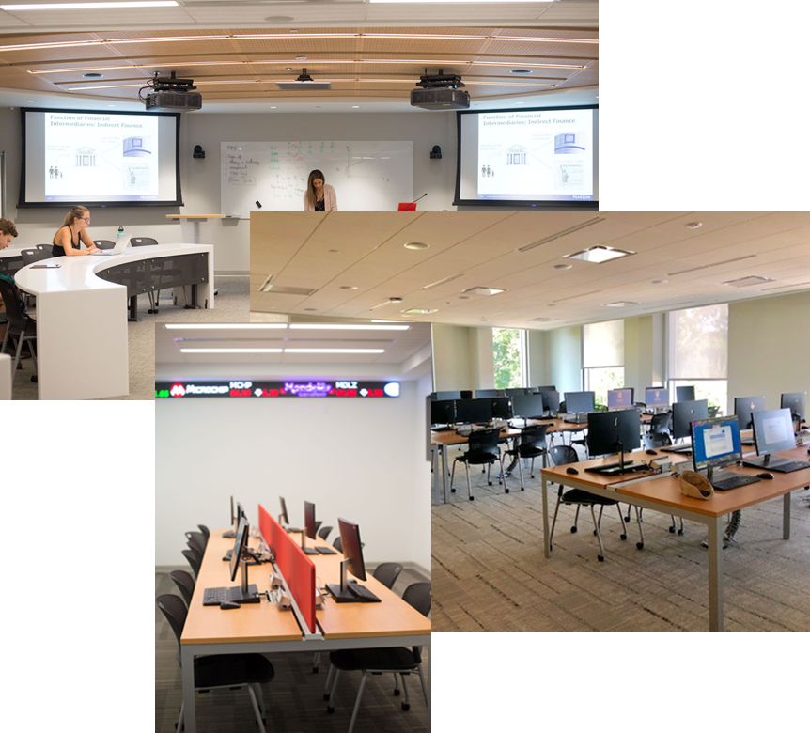
Information Technology Services
Support
Service
Information
Contact Us: ITSHelpDesk@Fairfield.edu or 203-254-4069
Follow Us:

Slide 4
Dining
Grab & Go or Grab & Sit options for all residential students beginning fall 2020; could be short term or long term
Possible transition to regular sit-down at a later date (The Tully, Oak/Dogwood, Tent, & Faber)
Safety and social distancing are priorities in a sit-down dining environment

Slide 5
Dining
Wide time frames will be offered on class days to maximize speed of service
Same menu at all dining locations
Possible limit on dining seating to 30 min
Allergy/special diet needs located in The Tully Simply Servings area
No guests or visitors at dining locations

Slide 6
Dining Locations
Tully Dining Commons: social seating max 300 (Jogues 300, Campion 238, Total Seats 538)
Tent: social seating max 100 (Regis 287, Gonzaga 198, Total Seats 485)
Oak Room w/ Dogwood Room Serving Area: social seating max 100 (McCormick 132, Total Seats 132)
Faber Dining Hall: social seating max 60 (Faber 143)

Slide 7
Textbook Ordering
Course schedules and sections will be posted in early July
Fairfield University requests that members of the Class of 2024 order from the bookstore since those selected texts will be delivered direct for pickup at the campus store easing the burden on our campus mailroom

Slide 8
Trolly & Stag Bus
Trolly and bus service available to the town of Fairfield every 30 minutes
Trolly/Bus on class days begins 7 a.m. in front of the Barone Campus Center traffic circle w/ final run drop off only at 10 p.m.
Saturdays/Sundays & Holidays service to town begins at Noon to 10 p.m.

Slide 9
Service to New York City Airports
On the Monday & Tuesday before Thanksgiving, on the final two days of December exams, and on Holy Wednesday and Holy Thursday, there is a FREE shuttle bus to the NYC airports of JFK and LaGuardia at the following times:
JFK at 8 a.m. and 2 p.m.
LaGuardia at 8 a.m. and 2 p.m.
Sign up in the Office of Conference & Events Management, Barone Campus Center, Room 212 beginning 60 days before flight.

Slide 10
First Year Experience (FYE) Seminar
Each student is assigned to a FYE Group with a New Student Leader (NSL) and a Community Associate (Staff/Faculty).
Together, the NSL and CA co-facilitate a weekly seminar over the fall semester
FYE curriculum intentionally created to help students navigate the transition process, with seminar topics including: navigating the academic, social and emotional transition, academic advising, the course registration process, goal setting, leadership development, etc.
In addition, each first-year student attends FYE events throughout the semester aimed at helping students connect with others students and resources at the University, and inspiring them to explore important topics/issues facing the world today

Slide 11
Student Engagement
Undergraduate Student Life, Graduate Student Life & International Student Life
New Student Experience
Orientation & Fall Welcome
First Year Experience & Transfer Student Experience
New Student Leader
Parent/Guardian Webinars
Campus Community Events
Welcome Week
Alumni & Family Weekend
Concert (FUSA)
Activities Fairs
Clam Jam
Presidential Ball (FUSA)
Leadership & Civic Engagement
Voter education
Across the Aisle Series
Leadership development initiatives
Fairfield University Student Association (FUSA)
Student government
Diversity & Inclusion
Clubs & Organizations
Programming
F@N – Fairfield @ Night
Late night and weekend events (in-person and online)
Stay Connected
Life@Fairfield
One-stop-shop of all things engagement
#TheWeekender
To learn about what’s happening from the next week

Slide 12
Student Diversity & Multicultural Affairs
Diversity and Inclusive Excellence Statement
Inclusive Excellence
A Diverse Community
Global Engagement
Radical Hospitality
We promote and foster Diversity, Equity, and Inclusion among students within the Fairfield community through engagement.
Notes:
The Office of Student Diversity and Multicultural Affairs seeks to develop and implement programs and services that will increase the engagement of students in activities that promote and foster inclusion among students within the Fairfield community.
Students will obtain a greater understanding and appreciation of diversity, inclusion and social justice.
Participate in affinity student organization and students sponsor cultural programs and activities
Intrinsic to our mission, individuality and diversity are honored and embraced at Fairfield
Programs such as Academic Immersion, Cura Personalis, Safe Space Training, Multicultural Retreat, and the Multicultural Curriculum Program are in place to support students in their journey through college
Office works closely with members of the faculty and Project Excel, a Trio program that helps first-generation college students and students of color.
Inclusive Excellence as a critical dimension of our academic mission. We strive to educate through engaging with the broadest possible range of dynamic ideas, perspectives, and identities in an ever-changing world. Embracing the challenges of competing viewpoints is integral to the rigor of our academic enterprise, pushing the horizons of what is known and possible as we pursue our commitment to excellence in teaching and learning.
A Diverse Community, which is a distinguishing hallmark of Jesuit education. We recognize the inherent value and dignity of each person, guided by our Jesuit heritage as informed by the contemporary context. Fairfield is committed to shaping a community of learners from diverse social, economic, racial, cultural, national, and religious backgrounds.
Global Engagement as a defining outcome of a modern Fairfield education. We hope to develop men and women to serve as global citizens, at home in the world, able to engage in diverse cultural circumstances with an open mind and the capacity to empathize with the perspectives of others. We actively promote an awareness of and sensitivity toward the full range of differences within and well beyond our community of learners.
Radical Hospitality as a way of relating with others, shaped by our Jesuit traditions. Fairfield recognizes the importance of learning about, and living in, an increasingly interconnected, intercultural world and reflects this by striving to become a microcosm of the global community, in which the other is unconditionally welcomed, respected, and valued.

Slide 13
Student Diversity & Multicultural Affairs
Office Programs and Initiatives
Academic Immersion
Cura Personalis
Safe Space Training
Multicultural Retreat
Fairfield United
Men of Color
Women of Color
Office works closely with members of the faculty and Project Excel, a Trio program that helps first-generation college students and students of color.
Student Emergency Support Services (Homeless, Hunger)
Notes:
The Office of Student Diversity and Multicultural Affairs seeks to develop and implement programs and services that will increase the engagement of students in activities that promote and foster inclusion among students within the Fairfield community.
Students will obtain a greater understanding and appreciation of diversity, inclusion and social justice.
Participate in affinity student organization and students sponsor cultural programs and activities
Intrinsic to our mission, individuality and diversity are honored and embraced at Fairfield
Programs such as Academic Immersion, Cura Personalis, Safe Space Training, Multicultural Retreat, and the Multicultural Curriculum Program are in place to support students in their journey through college
Office works closely with members of the faculty and Project Excel, a Trio program that helps first-generation college students and students of color.

Slide 14
Department of Recreation (RecPlex)
Recreation Facility:
Cardio, Strength, Pool (8-Lanes), Studio Spaces, Racquetball, Indoor Track, Fieldhouse)
E-Gaming Lab (*New 2020)
Recreation Programs:
Competitive Sports (Intramurals and Club Sports)
Fitness & Group Exercise (Yoga, Zumba, Spinning)
Recreation Services:
Equipment rentals (Basketballs, ropes, bands)
Employment (One of the largest on campus)
Body Composition Analysis

Slide 15
Office of Residence Life & Commuters
Transition, Sense of Belonging, & Student Success
Residence Life Team
Area Coordinator & Team of Resident Assistants (RA) & Commuter Peer Assistants (CPA)
On-Call and Duty Rotation for Safety & Support
Engagement Opportunities
Inter-Residential Housing Association (IRHA) & Commuter Association
First-Year Living and Learning Communities (LLCs)
Sophomore Residential Colleges
Residence Life Programming from IRHA & RAs
Living Together in Community
Shared Expectations & Communication
Welcoming, Empathetic, Caring, and Respectful Individuals

