Slide 1
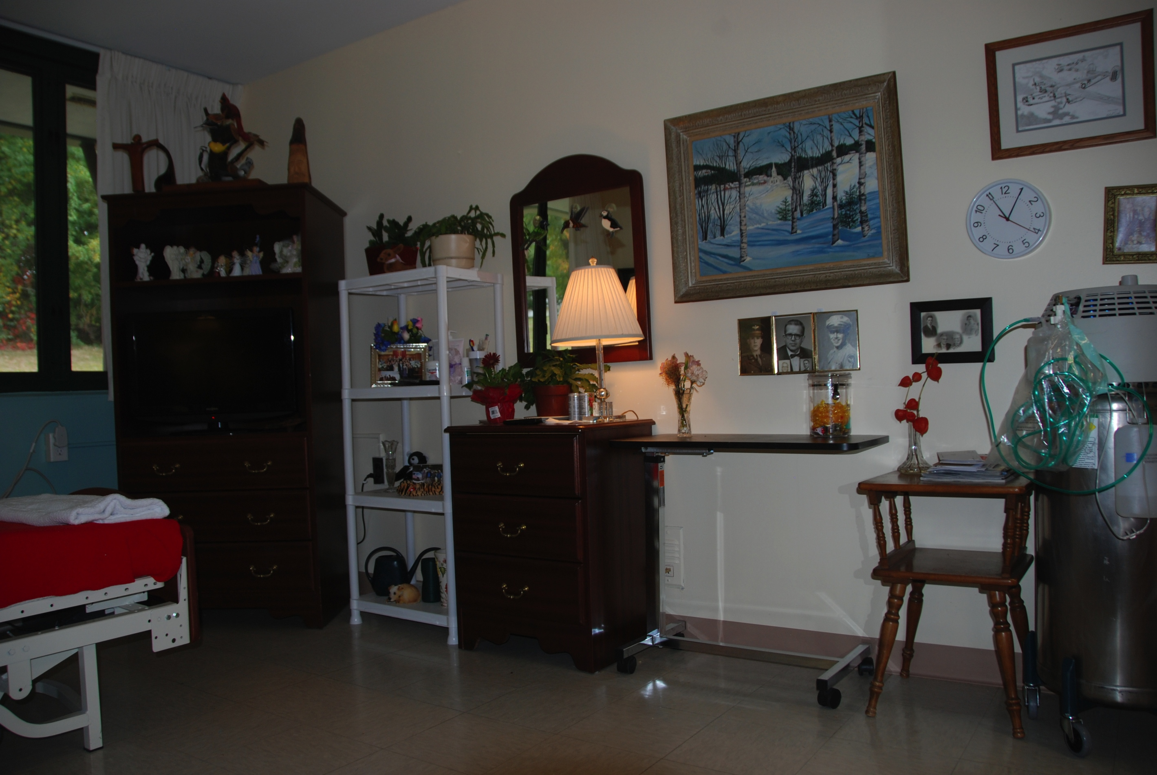
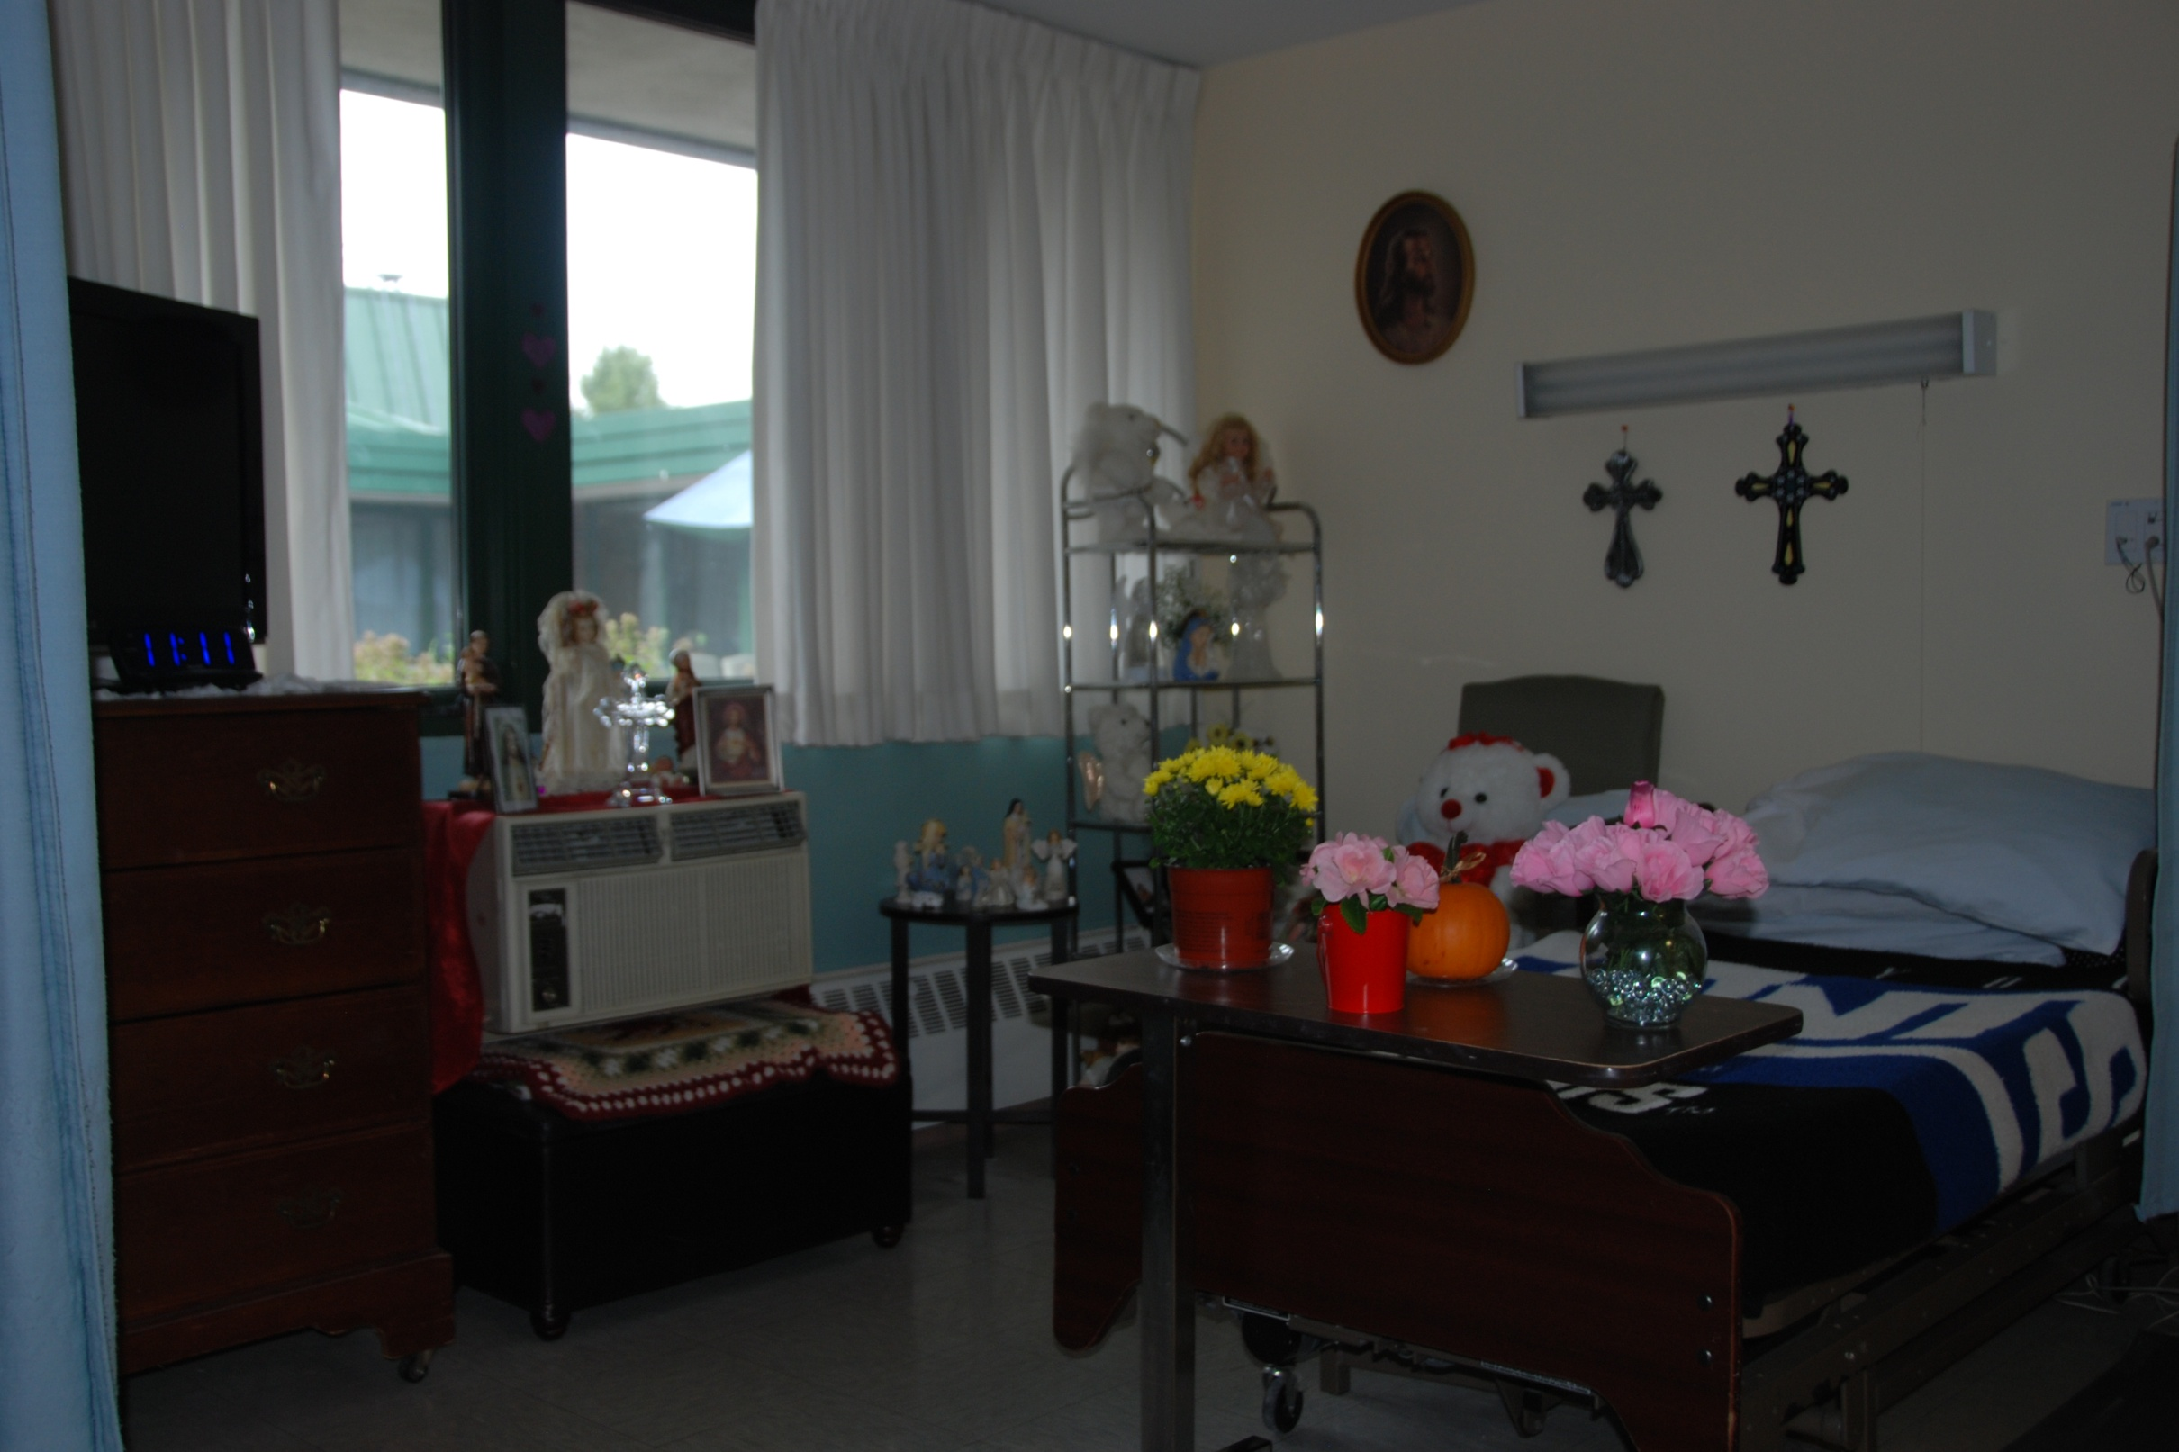
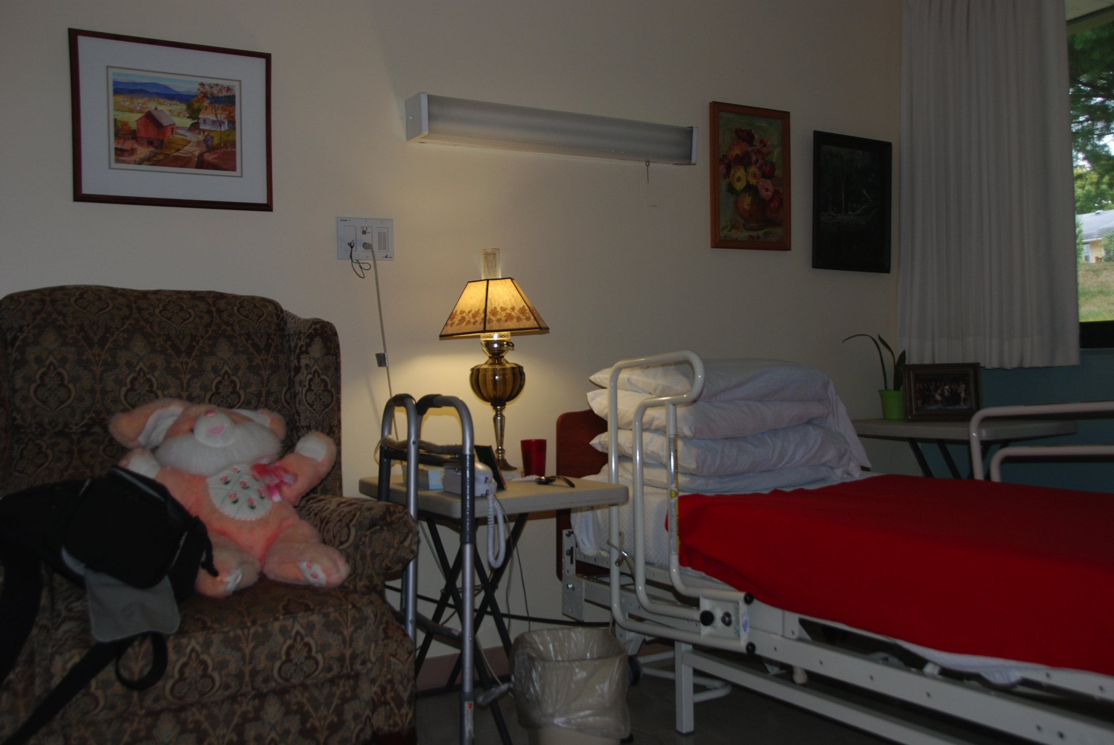
.
The Presence of Cognitively Enriched Environments for Nursing Home Residents with Dementia
Kaitlyn Krauss, Alison Kris, Sarah Birney, Linda Henkel
Fairfield University
.
INTRODUCTION
RESULTS
RESULTS
DISCUSSION
Creating a homelike environment can positively affect social interaction sand behavior and lessen confusion and anxiety in individuals with dementia (Edvardsson, 2008). The objective of this study is to determine if there are positive consequences to having nursing home residents display personal photos and other memory cueing objects around their rooms and around the facility. We are particularly interested in whether nostalgia invoking environmental stimuli will engage nursing home residents and their caregivers to reminisce. Nursing home residents reported engaging in reminiscence to maintain intimacy, nurture social bonds, and teach others. Previous research has shown benefits of reminiscing in terms of improvements in older adults’ health and well being, depression, reduced anxiety about death, and increased feelings of social connectedness (Gerben et al., 2010; Gudex et al., 2010; Subramaniam & Woods, 2012).
Residents living in enriched environments had numerous objects that were personally meaningful. These objects were capable of stimulating memories and conversations about the personal past of the resident.
Residents living in poorly enriched environments had rooms that were either bare, or which contained objects that were unable to stimulate personal memories.
The care environments for the residents varied within facilities as well as between facilities. Residents who had a longer length of stay were more likely to have enriched environments.
CONCLUSION
The construction of enriched living environments may have a beneficial impact among cognitively impaired older adults. Residents reported that they enjoyed sharing personal experiences with healthcare providers, however this was rarely done. Residents expressed desire for more opportunities to reminisce with their healthcare providers in the nursing home setting. Including objects that can stimulate memory and can serve to engage residents in meaningful conversation may be of benefit. Additional research is needed to demonstrate the impact of an enriched nursing home environment.
METHODS
An enriched environment: Based on descriptions from field notes, this resident’s room was classified as rich. The paintings on the wall were done by both her mother and mother-in-law. On top of the armoire are carvings made by her husband who has passed away.
A less well enriched environment is depicted here. While the room has numerous decorations, such as dolls and flowers, they are not memory cuing.
Subjects:
23 nursing home residents in two Connecticut nursing homes
Procedure:
Data collection is ongoing. Field notes were collected, which centered on observations about the nursing home environment as well as resident rooms. Field notes were then coded and analyzed. Based on descriptions from field note data, the level of enrichment could be classified as rich, moderate, or poor. Data codes were validated through independent analysis and the development of consensus by the research team
REFERENCES
Characteristics of enriched rooms:
Contain numerous photos of family and friends
Provide orientation to the day, date ,and season
Depict scenes from several different time periods throughout a resident’s life: e.g., a wedding, a birth of a child, a retirement party
Stimulate the resident to recall life events that were personally meaningful
Edvardsson, D. (2008). Therapeutic environments for older adults: constituents and meanings. Journal of Gerontological Nursing,34, 32-40.
Gudex, C. et al., (2010) Consequences from use of reminiscence - a randomized intervention study in ten Danish nursing homes. BMC Geriatrics, 10, 33.
Gerben J., Westerhof,, E.B. & Webster, J.D. (2010). Reminiscence and mental health: a review of recent progress in theory, research and interventions. Ageing and Society, 30, 697-721.
Subramaniam, P., & Woods, B. (2012). The impact of individual reminiscence therapy. Expert Reviews Neurotherapy, 12, 545-555.
RESULTS
Characteristics of poorly enriched rooms:
Rooms were described as bare, or empty
While some contained objects, they did not reference life events that could have a broader stimulating effect on memory.
Examples of items in these rooms are flowers, stuffed animals, figurines, and tissue boxes.
Results from field notes centered on two main themes:
(a) the types of memory cueing items present in resident rooms ,and (b) efforts to make the facility more “home-like.” Based on descriptions from field note data, the level of enrichment in resident rooms could be classified as rich (n=9), moderate (n=7), or poor (n=7). There was significant variation in the level of enrichment between the two nursing homes.
An enriched environment: On this resident’s nightstand, is a lamp that she brought with her from home. To the right of her bed, is a picture of her husband along with her parents. Above her bed, are painting that were done by her mother. The resident recalled that these paintings remind her of the places she journeyed during her childhood.
ACKNOWLEDGMENTS
This study was funded through the Interdisciplinary Health Scholars Program at Fairfield University. We are grateful for the support of Dr. Lynn Babington (Dean of School of Nursing) and Dr. Robbin Crabtree (Dean of School of Arts and Sciences).
.

