Slide 1

Graduate Commencement
Guidelines 2014

Slide 2
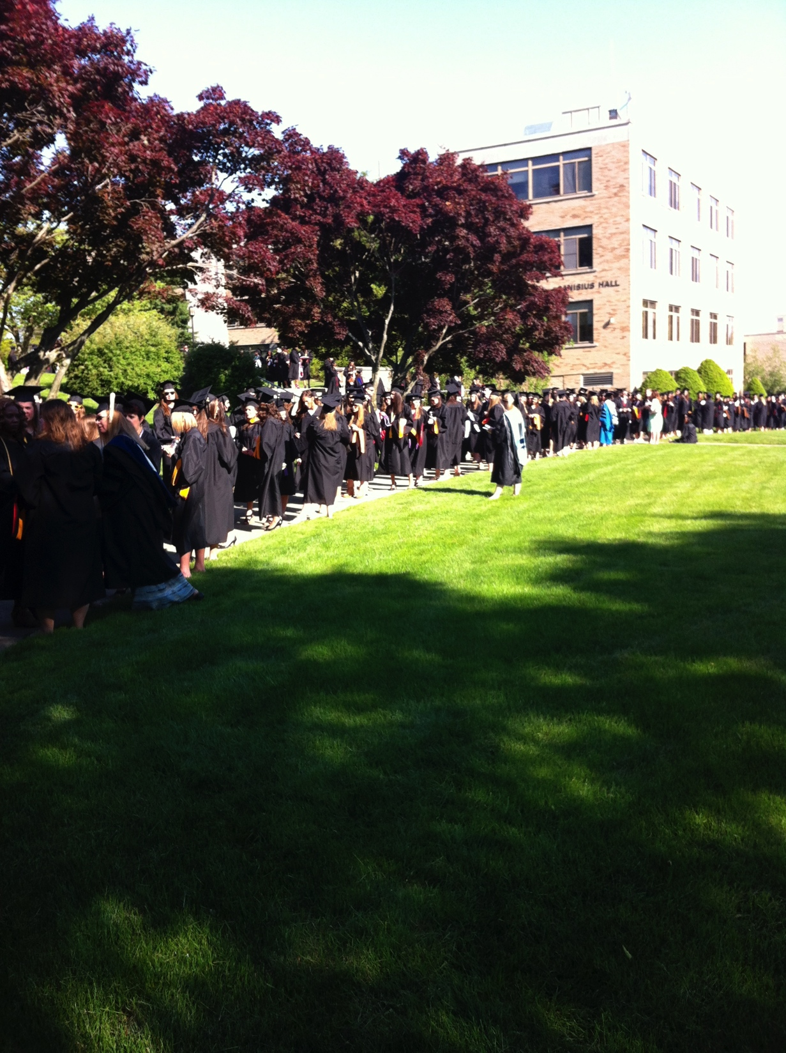
The Procession

Slide 3
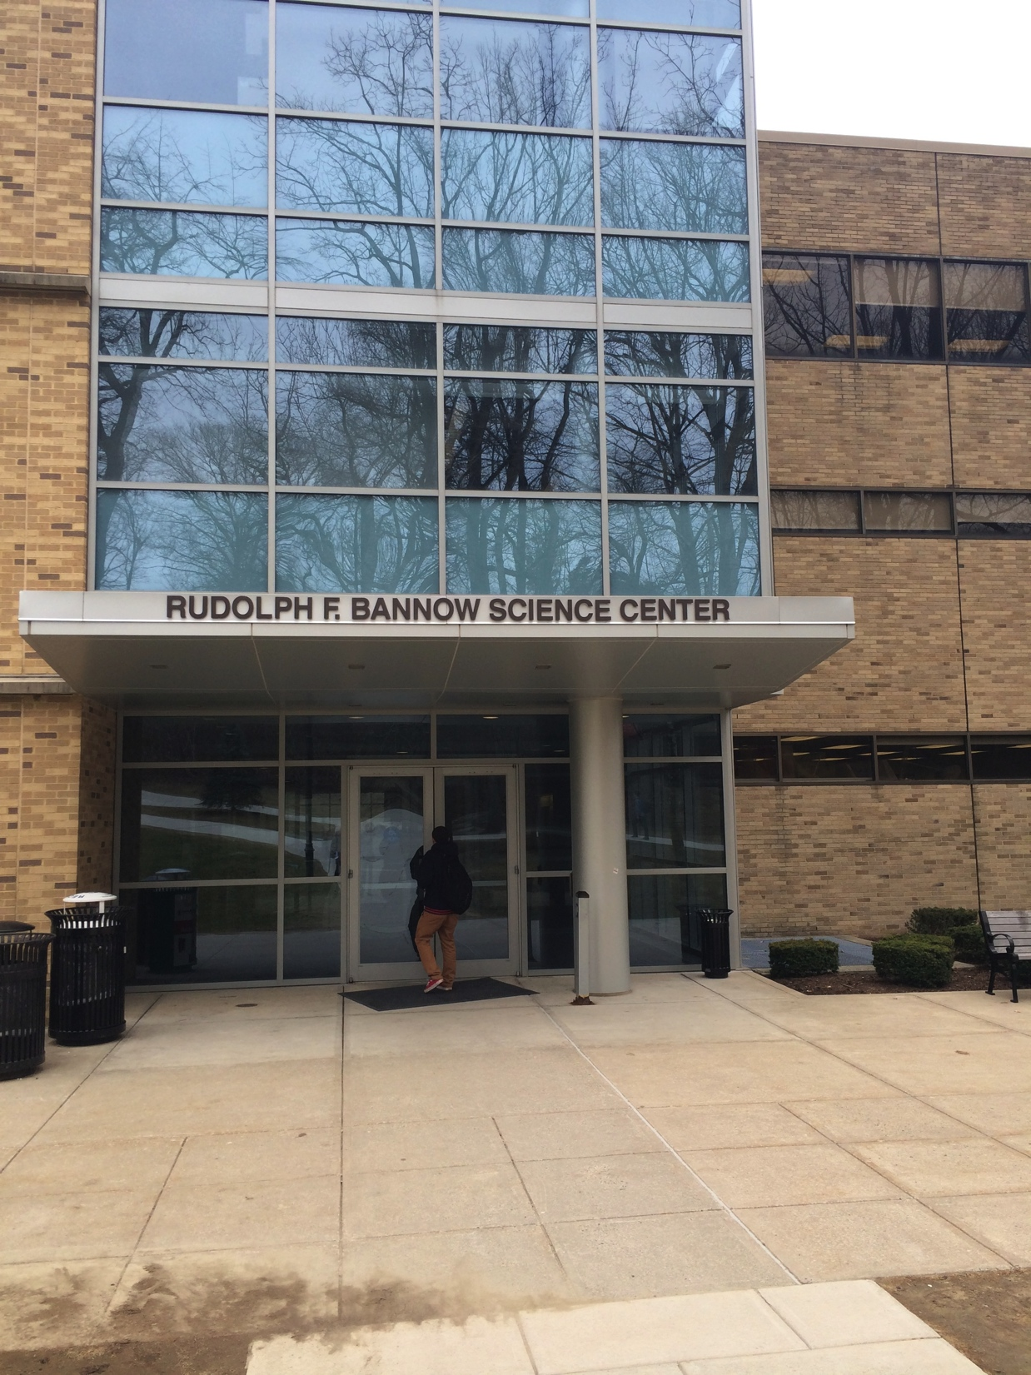
Line up- Bannow Science Center
Arrive at 1:30 PM
Note your classroom Exit staircase and doorway on Marshall list.

Slide 4
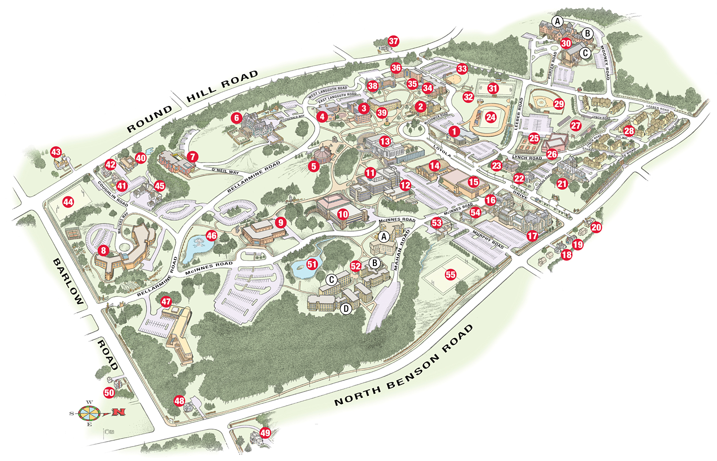

Slide 5
The Line Up
Faculty marshals will have name cards which they will use to line the graduates up alphabetically in each classroom:
Jan Smath
Jack Smith
Jill Smothe
Jim Smythe

Slide 6
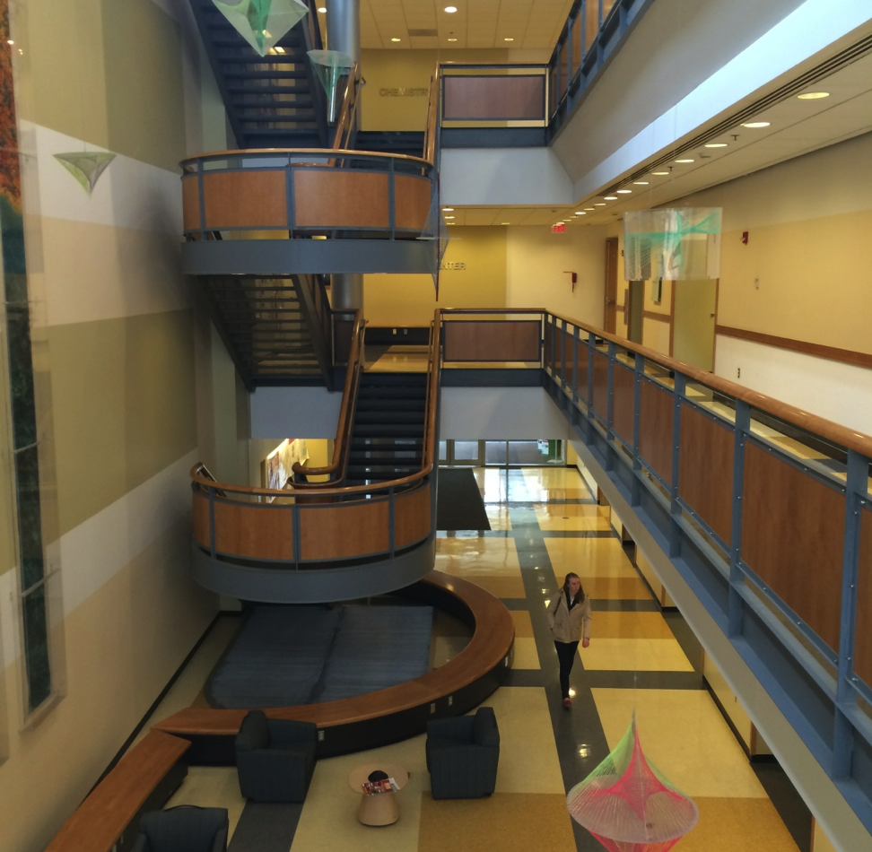
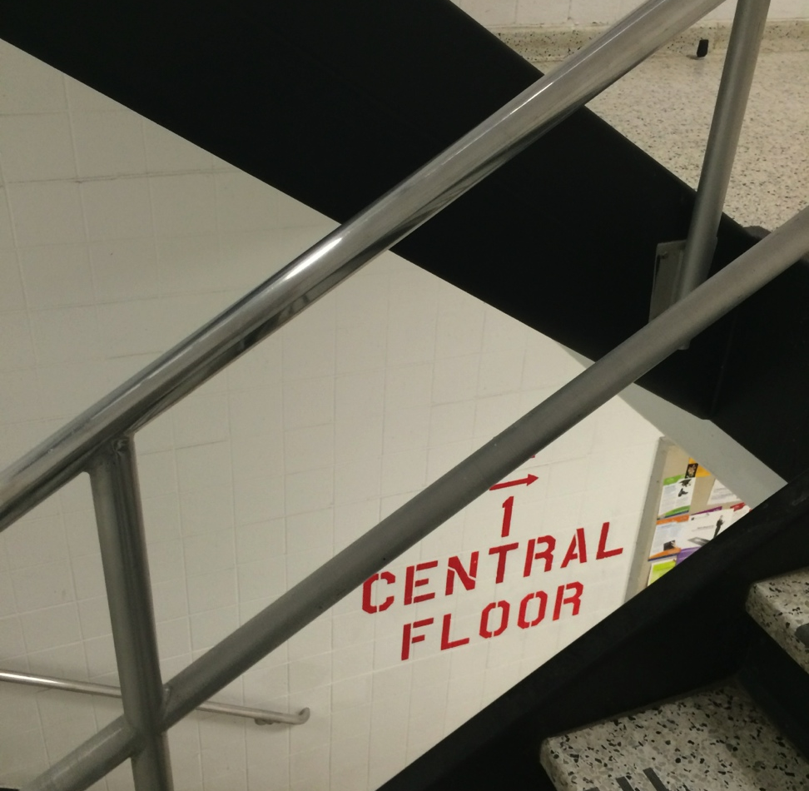
The March
Exit Stairwells
Bannow Atrium Exit
Bannow South Entrance

Slide 7

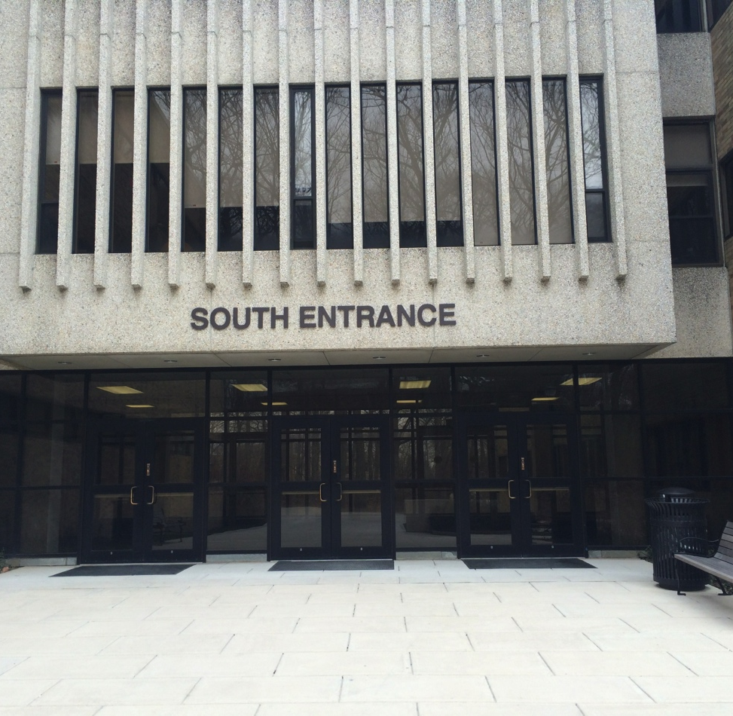
Exit Doors
Bannow Atrium Exit
(Seated RIGHT facing stage)
Bannow South Entrance (Seated LEFT facing stage)

Slide 8
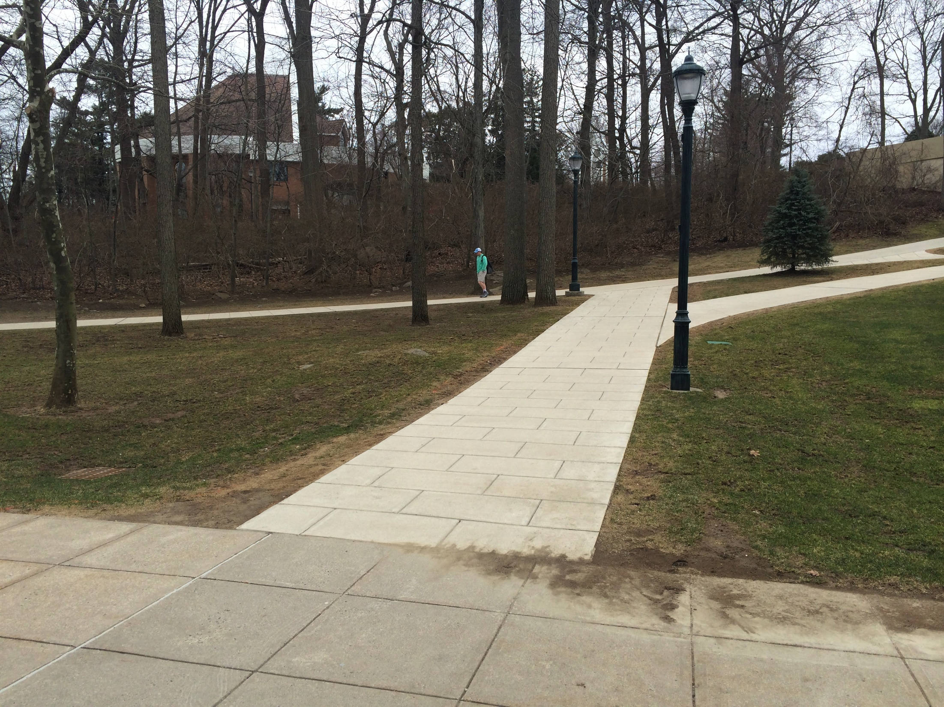
The March
BNW South
BNW Atrium

Slide 9
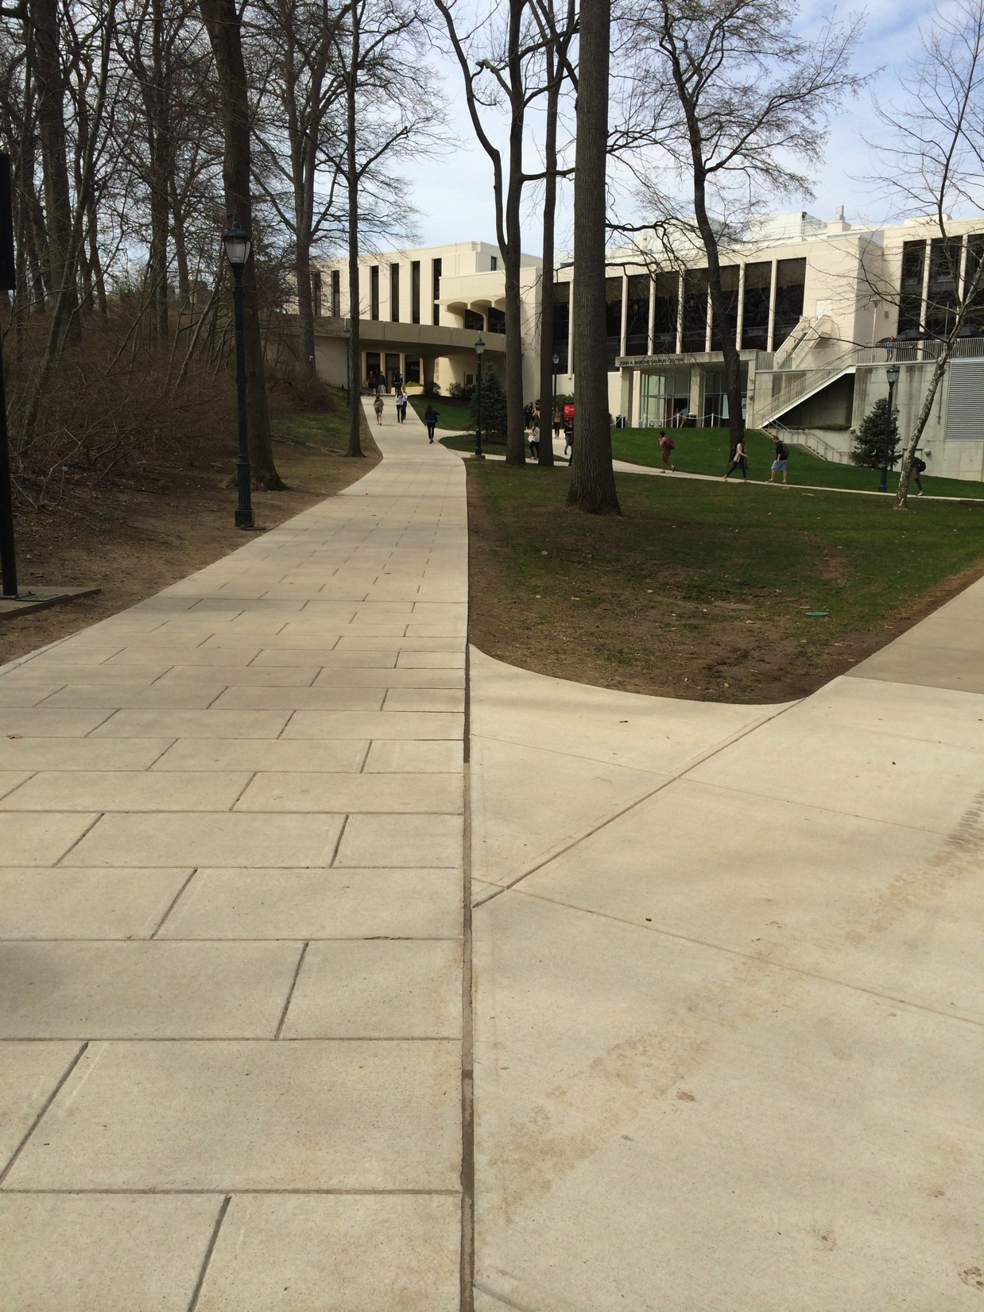
The March

Slide 10
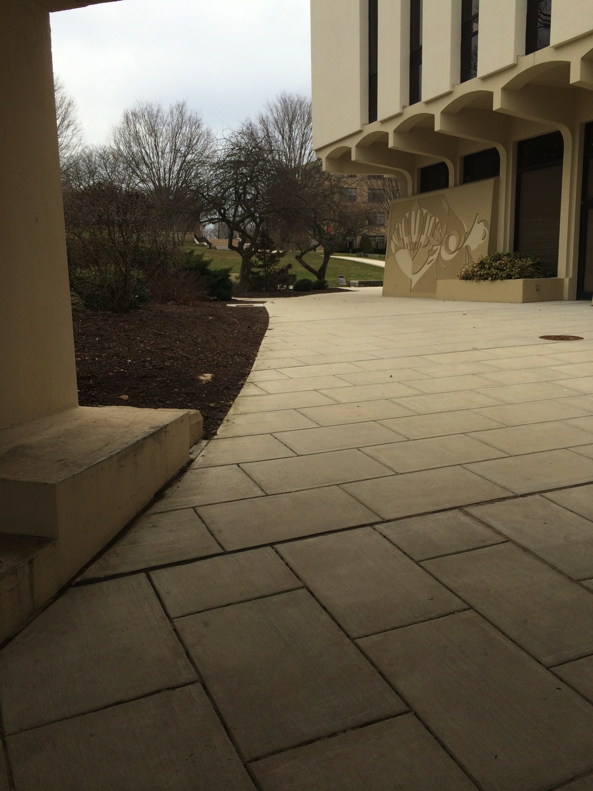
The March

Slide 11
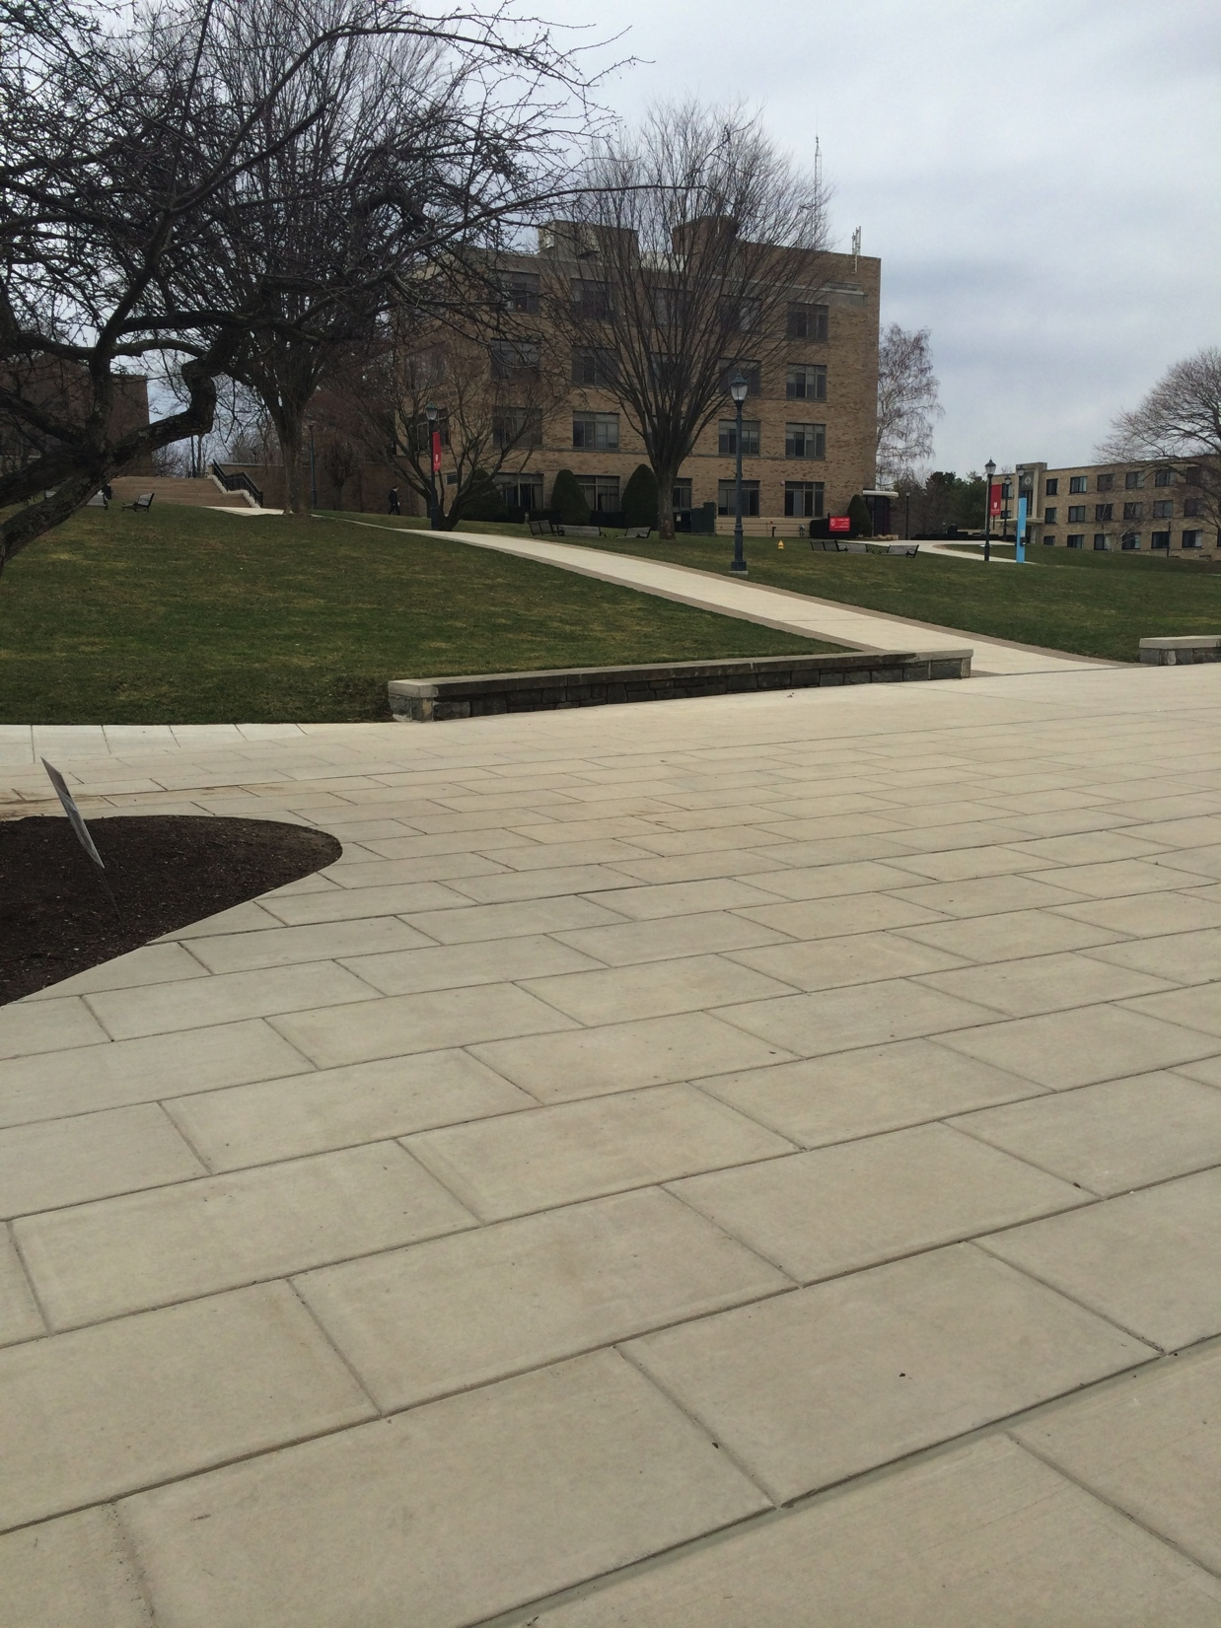
The March

Slide 12
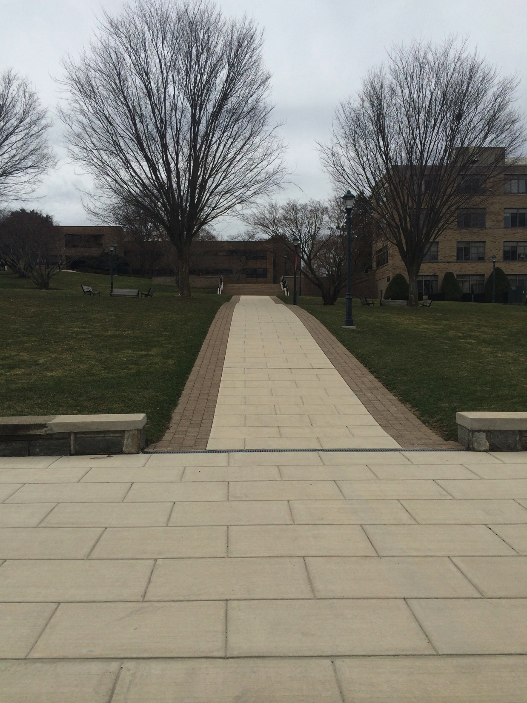
The March

Slide 13
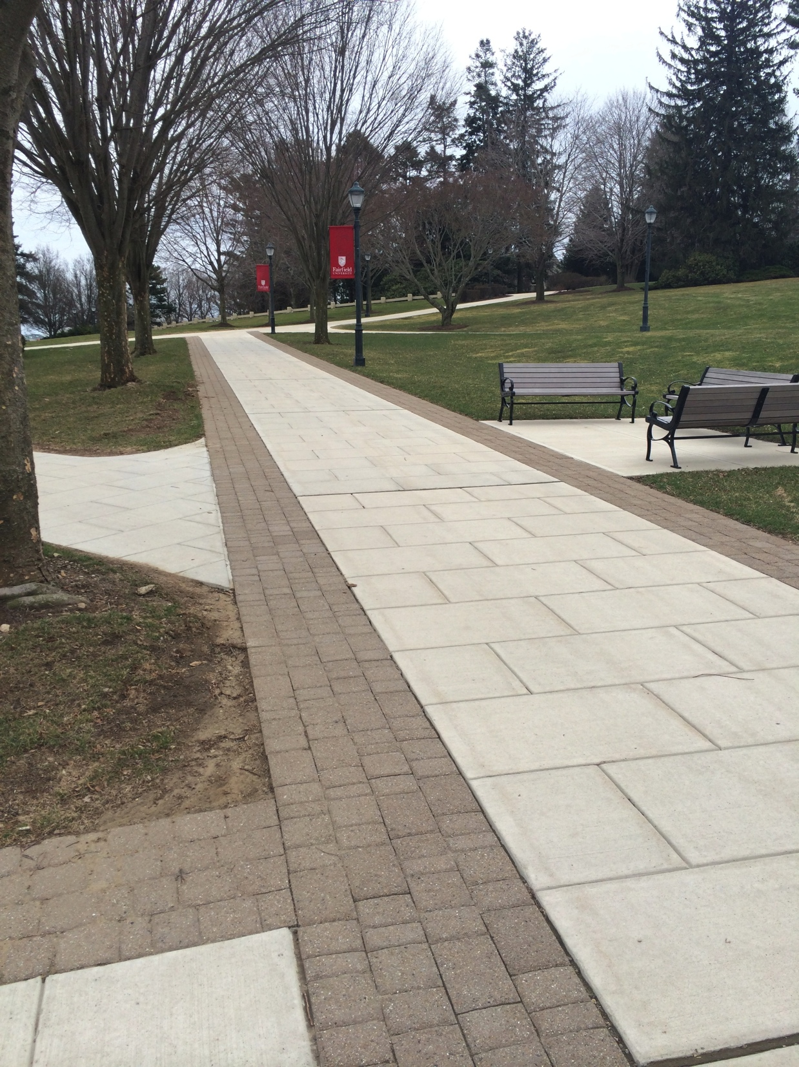
The March
BNW SOUTH
BNW ATRIUM

Slide 14
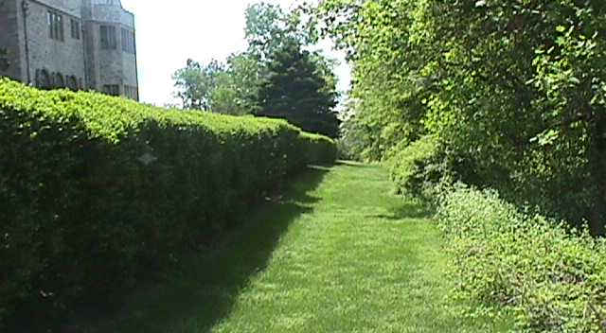
The March

Slide 15
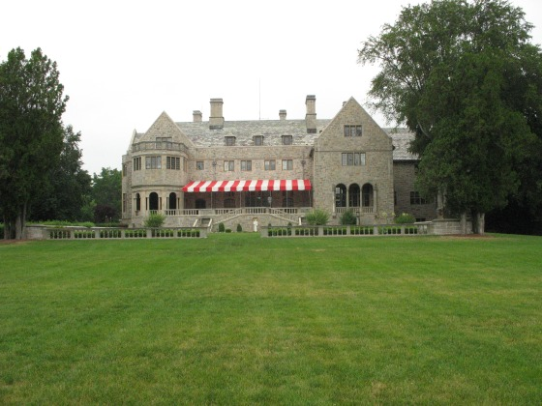
The March
BNW SOUTH
BNW ATRIUM

Slide 16
Terrace
FACULTY
FACULTY
SON – DNP
SON- MS
CAS – MA
CAS – MS
CAS – MFA
DSB – MBA
DSB – MS
SoE – MS
GSEAP – MA
GSEAP –
Certificate of
Advanced Study

Slide 17
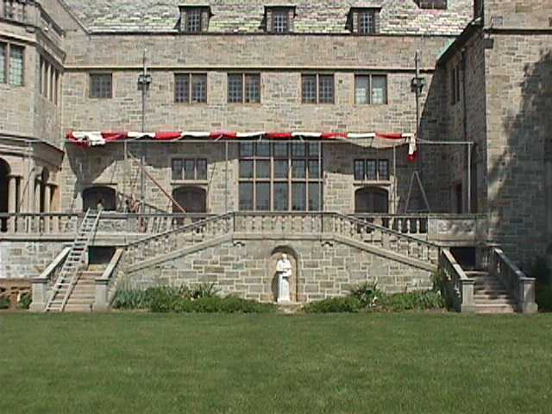
The March

Slide 18


The Icons

Slide 19

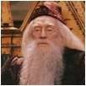
Terrace

Slide 20
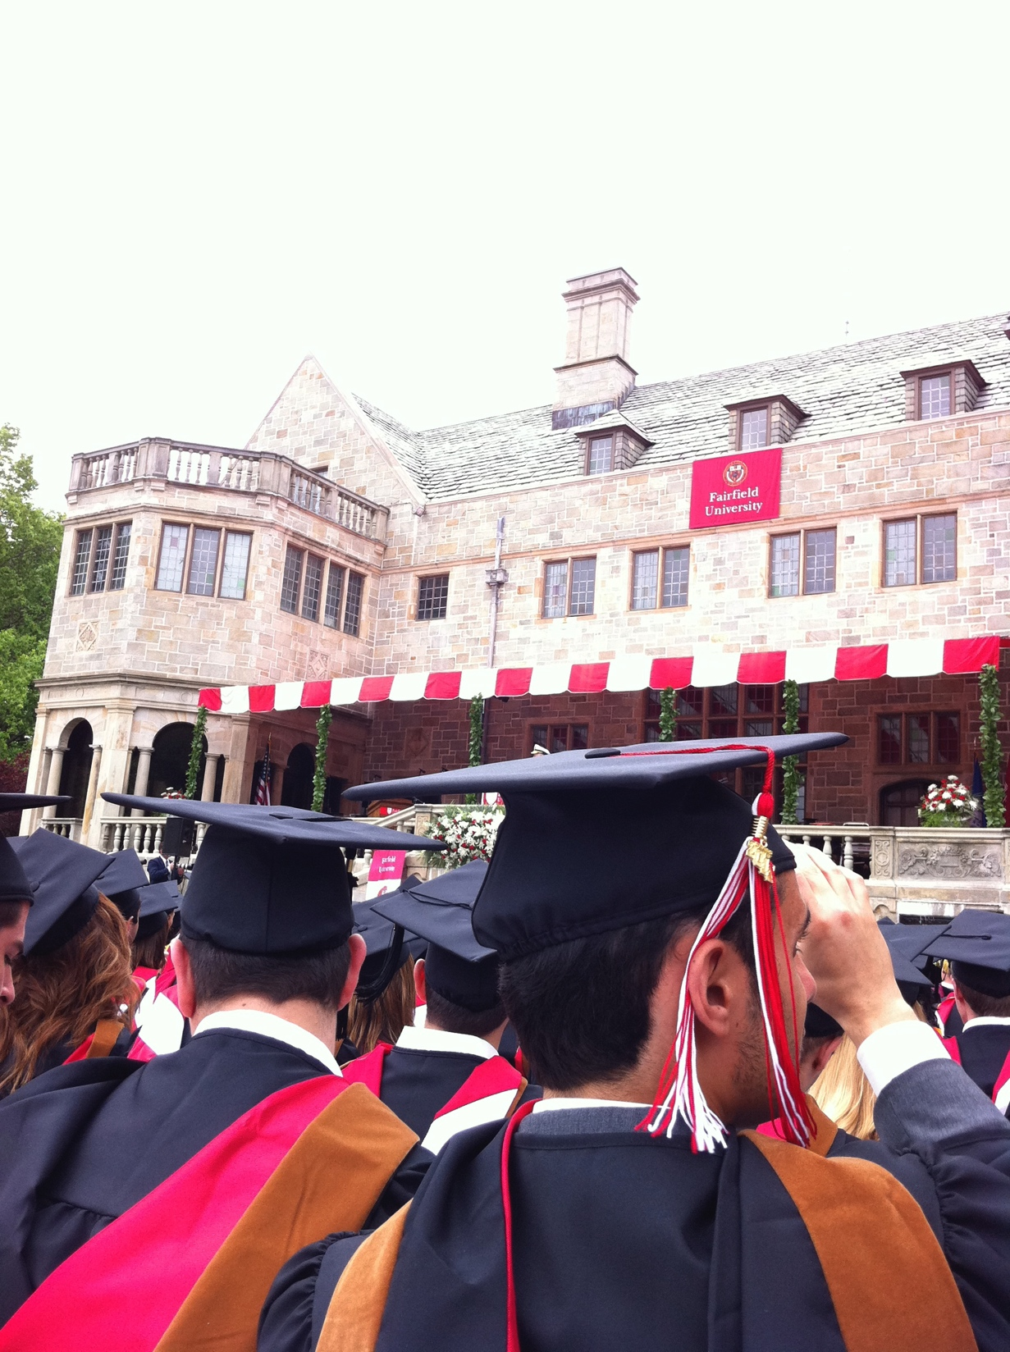
The Conferring of Degrees

Slide 21

Terrace

Slide 22

Terrace

Slide 23
The Recessional

Slide 24
Terrace

Slide 25
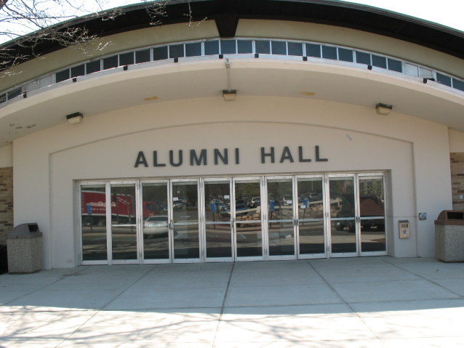


In the Event of VERY
Inclement Weather

Slide 26
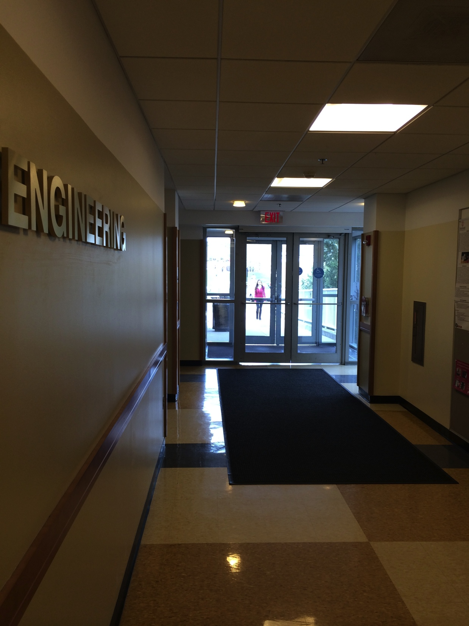
Line Up
BNW SOUTH

Slide 27
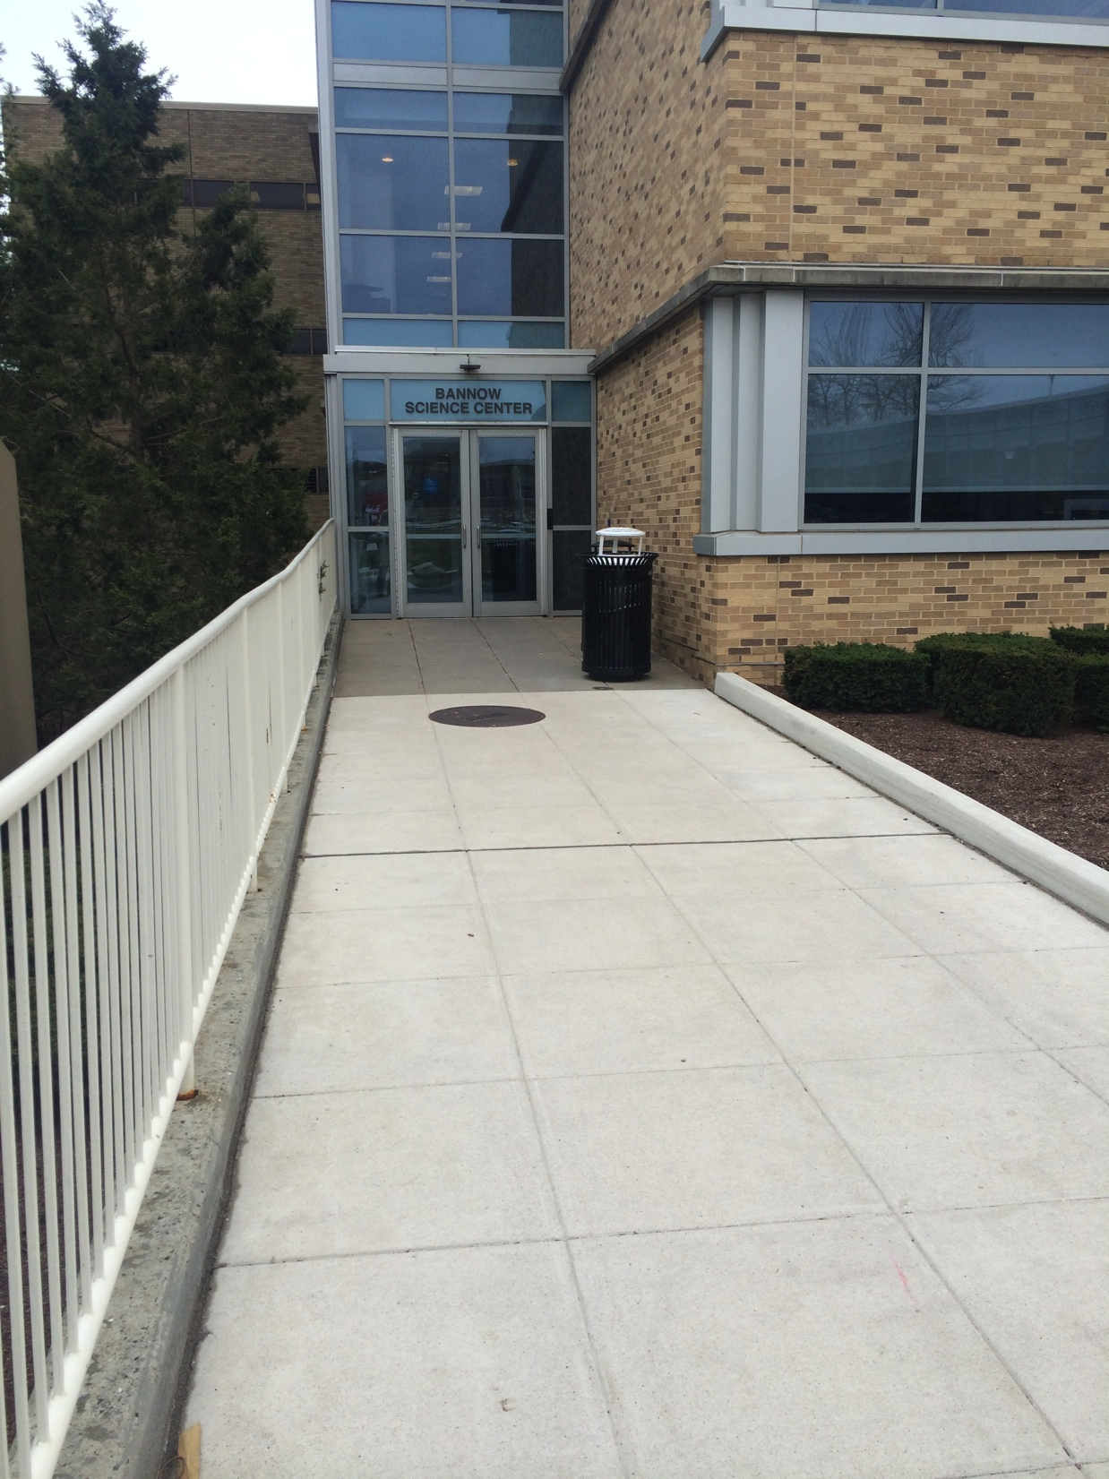
The March

Slide 28
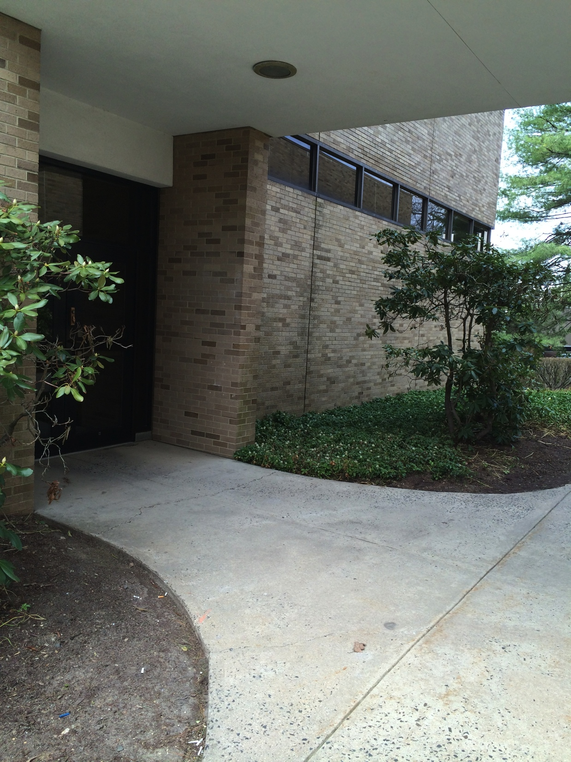
The March
IMG_1430
BNW ATRIUM

Slide 29
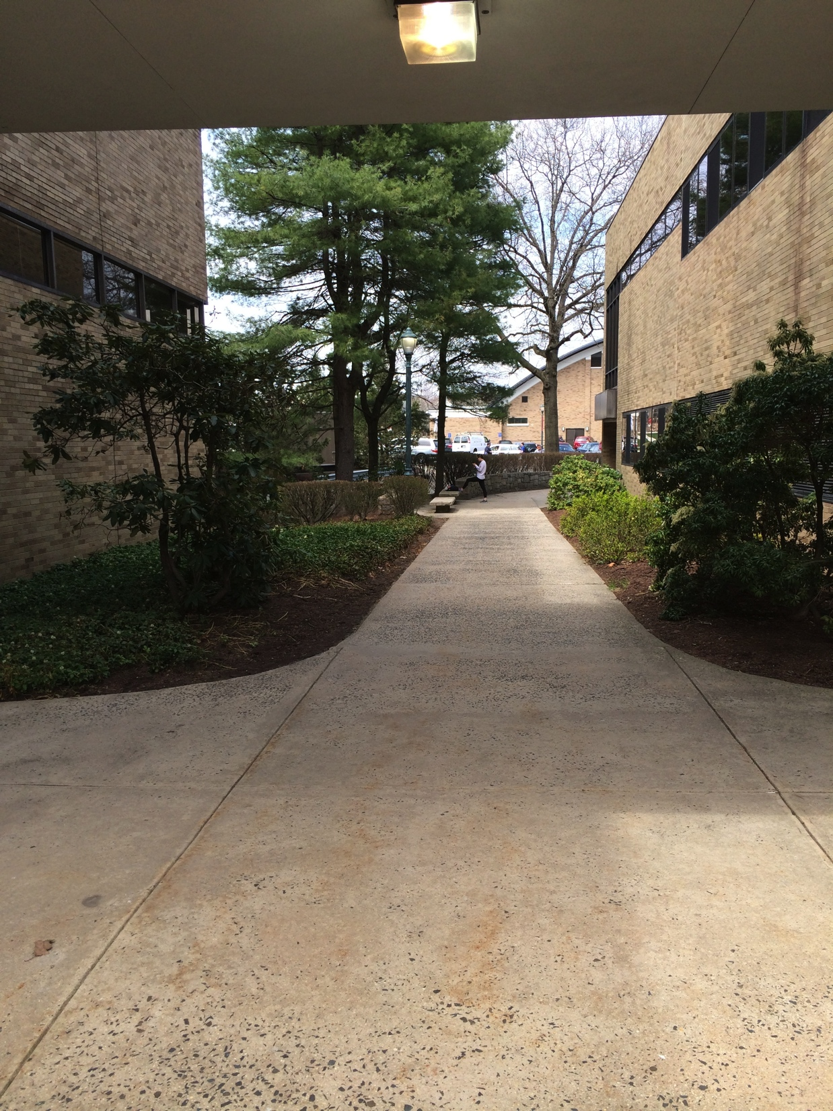
The March

Slide 30
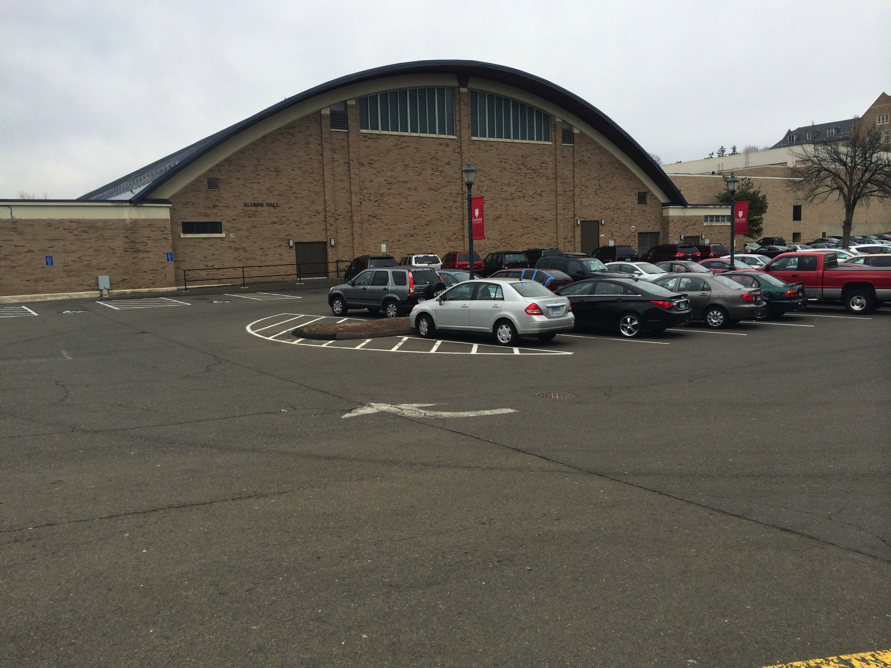
The March

Slide 31
STAGE
B
L
E
A
C
H
E
R
S
B
L
E
A
C
H
E
R
S
Floor Seats
Floor Seats
Bleachers
Bleachers
Bleachers
ALUMNI HALL

Slide 32
The Conferring of Degrees

Slide 33

STAGE
B
L
E
A
C
H
E
R
S
B
L
E
A
C
H
E
R
S
Floor Seats
Floor Seats
Bleachers
Bleachers
Bleachers
ALUMNI HALL

Slide 34
The Recessional

Slide 35
STAGE
Floor seats follow platform party
B
L
E
A
C
H
E
R
S
B
L
E
A
C
H
E
R
S
Floor Seats
Floor Seats
Bleachers
Bleachers
Bleachers
ALUMNI HALL

Slide 36
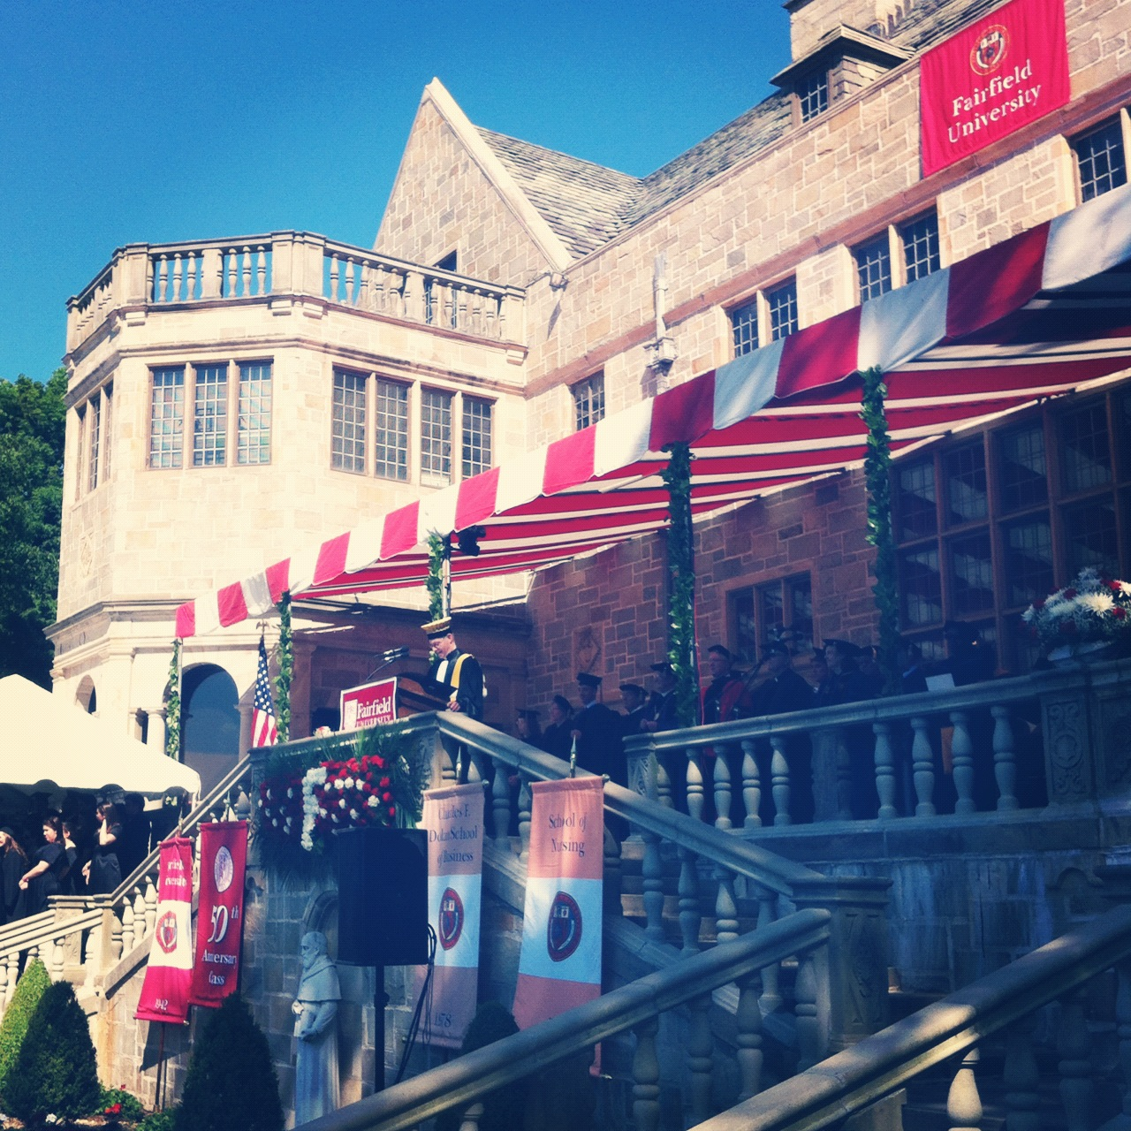
Reminders
Wear comfortable shoes.
No bags on field.
Don’t leave valuables in classrooms.
Be on time!

