Slide 1
Welcome Home! Class of 2024 Move-In Logistics
August 11, 2020
12 p.m. EST
Notes:
Marissa - intro

Slide 2
Introductions
Dean of Students
Health and Wellness
Public Safety
Residence Life
Student Engagement
Notes:
Meredith Smith --
Students Arriving from Abroad & Hot Spots
Students Arriving regularly scheduled

Slide 3
Important Note
International
CT State Travel Advisory
Hot Spot/International Arrival
Webinar at 2pm Today with
Vice President of Student Life
Notes:
Meredith – we will be taking question via Q&A may not get to all them, please submit your question.

Slide 4
Thursday, August 27, 2020
&
Friday, August 28, 2020
Official Move-In Days for
Class of 2024 & Transfer Students
Notes:
Marissa day dates

Slide 5
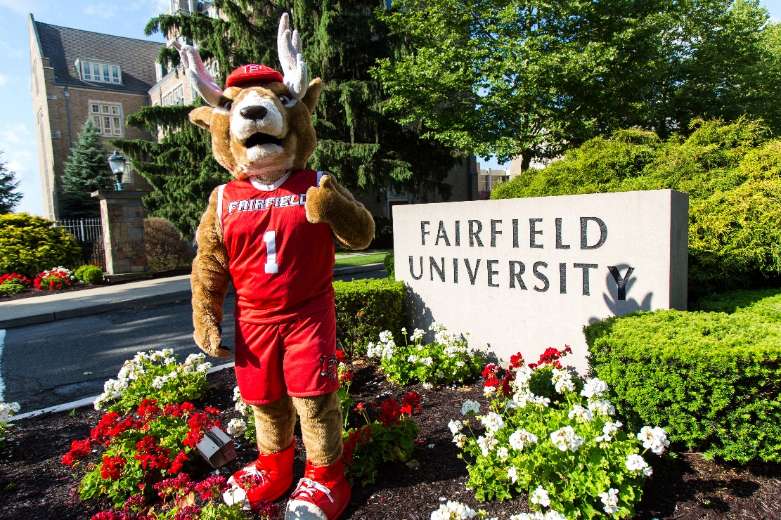
Stags Come Home Website
fairfield.edu/reopen
Notes:
Marissa
Fall Welcome

Slide 6
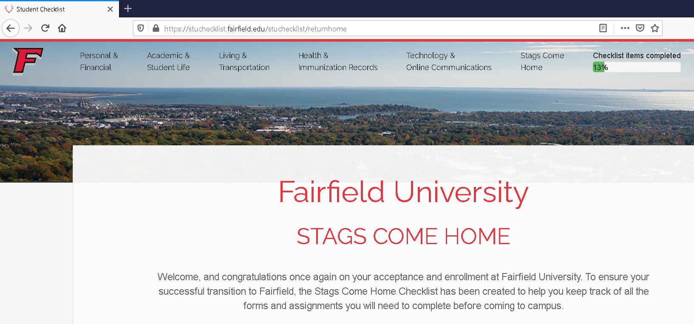
Before You Arrive
Student Health & Testing
First-Year Checklist
Keep checking your email for updates
Notes:
Susan Birge – Health and Testing (Requirements) & Note Hot Spot States
Allison – Social Pledge
First-Year Check – Most items have overdue deadlines

Slide 7
COVID-19 Pledge
“The purpose of this pledge is to illustrate the collective responsibility of all students to keep our campus and community safe given the current global pandemic. This pledge is rooted in our Jesuit tradition of being people for and with others, and serves as an acknowledgement of the new critical requirements pertaining to face covering, personal hygiene, cleanliness, and social interactions.”
Notes:
ALLISON

Slide 8
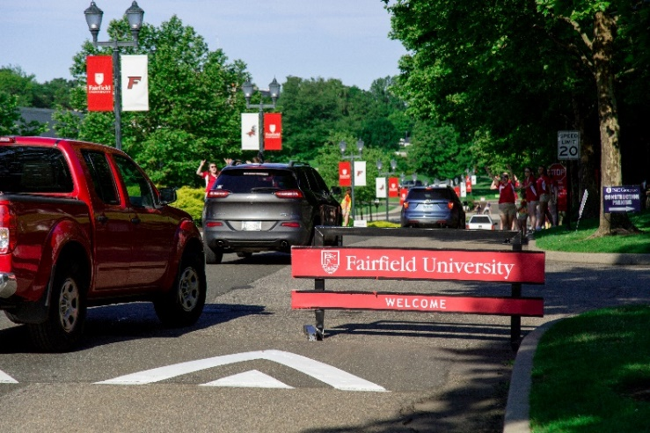
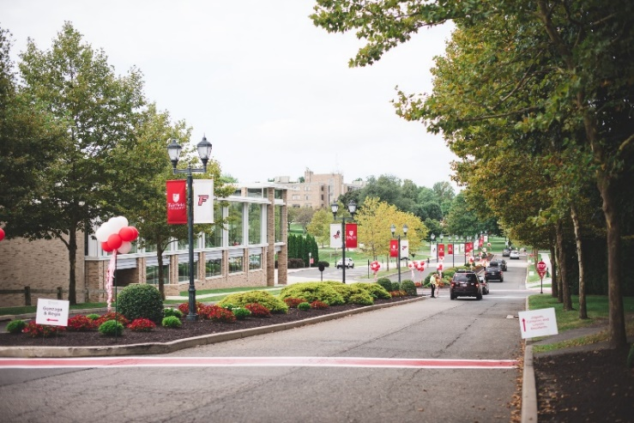
Move-In Overview
90-minute time slots starting at 7am and ending at 7:30pm
All cars will enter in through the Main Gate and show proof of passed LiveSafe Health Questionnaire for students and guests
Please do not arrive to campus prior to your scheduled move-in time. If you’re unable to make your time, contact studentmove@fairfield.edu
Notes:
Charlie – Overview
Action Item – Testing (call day before) and Notification system for Front Gate --- Staging Area for folks who don’t have completed items
Don’t come to campus if you don’t have this….Cleared to come to campus email? Health center communication (which checklist items prevent students from coming to campus)

Slide 9
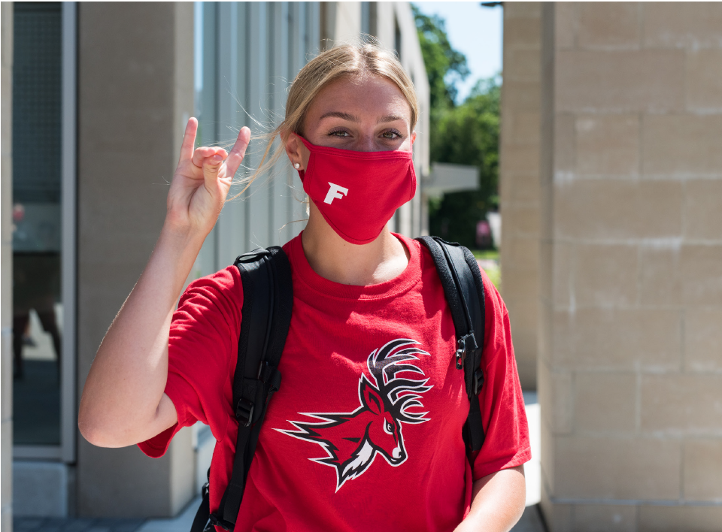
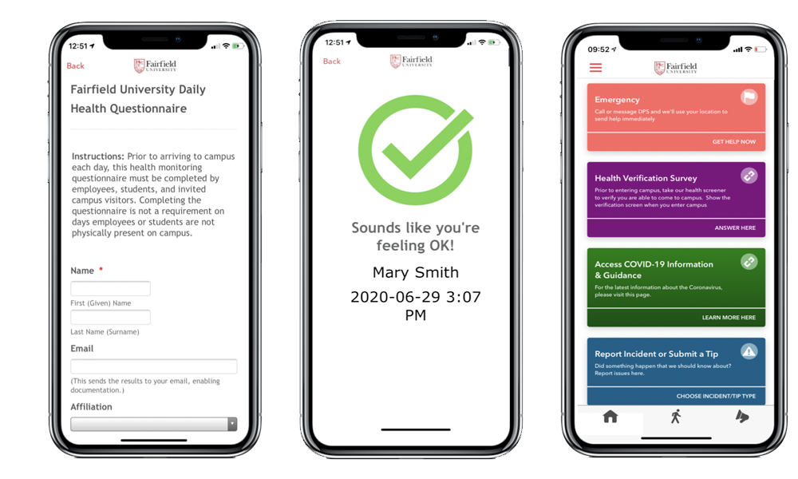
Day of Arrival
Everything completed to come to campus
LiveSafe Health Questionnaire for students & guests
2 guests per student (one must stay with vehicle)
All must wear masks & practice social distancing
Notes:
Frank

Slide 10
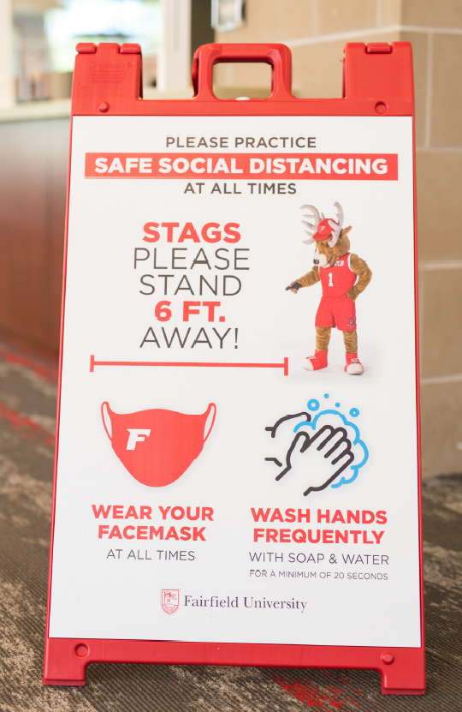
What to Expect When You Arrive
Front Gate
Traffic Pattern
Check-In
Parking
Departing from Campus
Notes:
Charlie

Slide 11
Traffic Flow
Enter through the Main Gate only:
Campion Hall, Jogues Hall, and Loyola Hall keep FORWARD
Gonzaga Hall and Regis Hall are to make an immediate left and follow the loop around campus
Transfer Students will receive specific instructions via email of which traffic pattern and check-in location to follow
Notes:
Charlie
- Quad or Southside

Slide 12
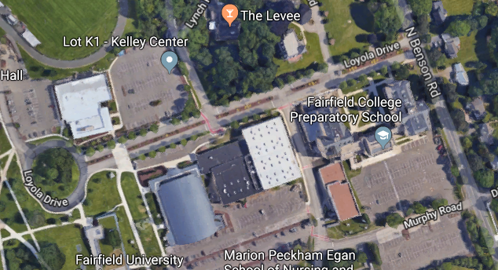
Gonzaga & Regis Halls Traffic Flow
Gonzaga & Regis Traffic
Parking Garage
Notes:
Meredith

Slide 13
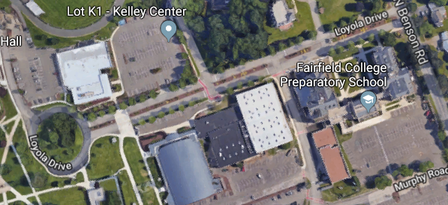
Campion, Jogues, & Loyola Halls Traffic Flow
Parking Garage
Campion, Jogues & Loyola Traffic
Notes:
Frank/Charlie
Add in volunteers – traffic gear directing you

Slide 14
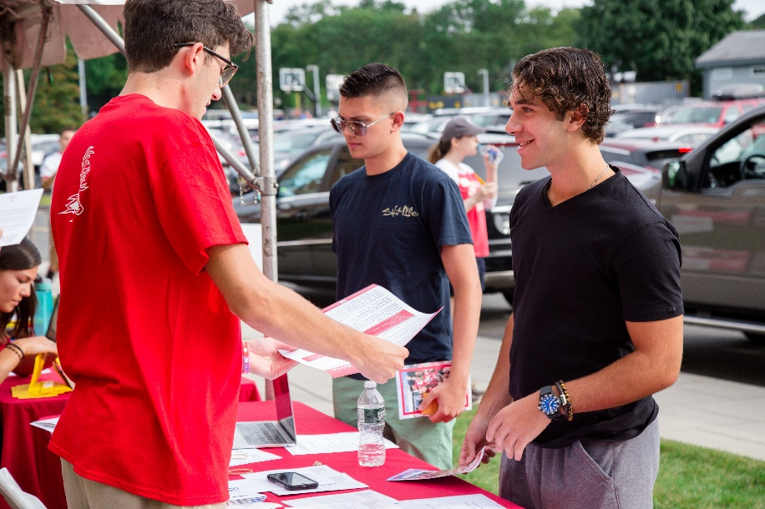
Class of 2024 Residents Check-In Process
Check-in locations
Staging Areas
Campion Gravel Lot (Campion, Jogues, Loyola)
Dolan School of Business Commuter Lot (Regis & Gonzaga)
Car pulls up
Student exit vehicle, go to tent
Pick up key and stag card
Return to vehicle
Released to area
Notes:
Charlie

Slide 15
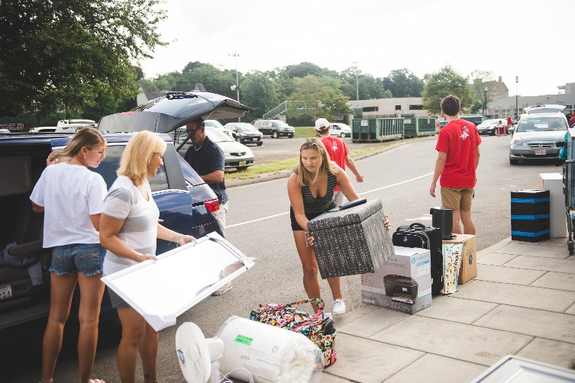
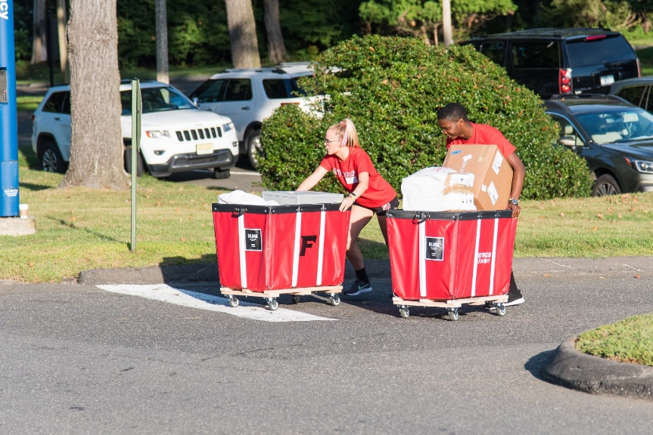
Building Move-In Specifics
Bins
Elevator
Masks must be worn at all times
Traffic flow within buildings
Notes:
Charlie

Slide 16
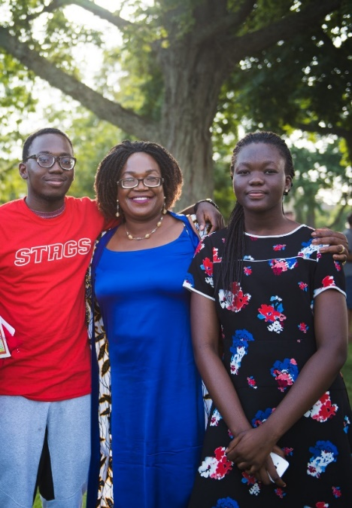
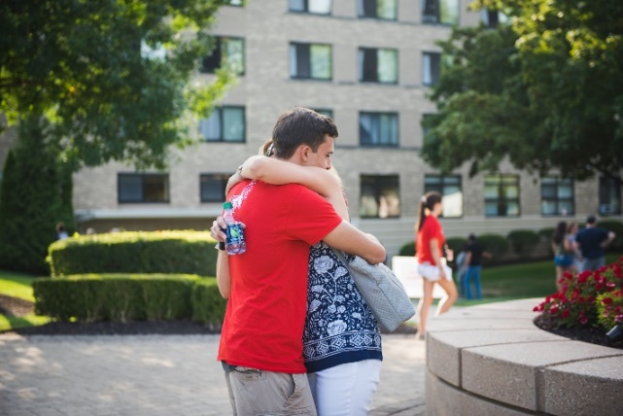
Families Departing from Campus
After 90 minutes, families will depart campus
Traffic flow
First-year students are not permitted to have cars on-campus
Blessing
Notes:
Frank –
- Get ready for next group of move-in
Exit Signage on-campus
Exit from the main gate.
Students after move-in
How are we departing campus? Where do we station campus min? Allison – Drive-up Blessing on their way out.

Slide 17
Packing Tips
Students are encouraged to keep personal belongings to a minimum for fall 2020. Students should pack what will make them feel comfortable, but also be prepared to move quickly if circumstances beyond our control will require Residence Hall closing without advanced notice.
For complete packing list, visit fairfield.edu/fallwelcome

Slide 18
Packing: What to Bring
Clothing
Everyday wear for September through November
Light jacket and rain gear
Workout/Wellness gear
Interview/Professional clothes
Health and Safety:
Washable Cloth Masks & Face Coverings
Digital Thermometer
Facial tissues
Small First-Aid Kit
Hand sanitizer
Prescription medicines (including inhalers for students with asthma)
Allergy medication (e.g. epi-pen, etc.)
Over the counter medications (i.e. Tylenol/Ibuprofen, Aspirin)
Lock box for controlled medications
Health Insurance Card
Notes:
Meredith/Susan
- Packing Light is KEY

Slide 19
Packing: What to Bring
Cleaning Supplies:
Sanitizing wipes
Dish soap
Duster/Swiffer
Small vacuum
Laundry basket/bag, mesh laundry bag to wash masks
Laundry detergent for high efficiency laundry machines
Dryer sheets
Academic Prep:
Headphones with Microphone for virtual meetings
Computer (laptop, with lock, recommended)
Webcam (if computer is not equipped)
USB flash drive or storage device
Backpack/book bag and personal planner
Textbooks
School Supplies (pens, pencils, notebooks)
Device chargers (phone, computer, tablet)
General Items:
Outdoor chair/Lawn Chair
Umbrella
Items for Hobbies (example: videogames, small sports equipment, sheet music)
Refillable/reusable water bottle
Snacks
Notes:
Meredith/Susan
- Packing Light is KEY

Slide 20
Packing: What to Bring
Room:
Comforter, sheet set, and pillows
Plastic containers with lids for storage (stackable containers are good)
UL-approved power strip
Desk lamp
Fan (if in non-air-conditioned Residence Hall)
Small recycling and trash bin
Pictures and posters to decorate the walls (blue tape or wall putty is recommended for mounting)
Small Roku enabled TV
Hangers
Personal Care
Bathrobe, shower shoes, towels, and washcloths
Soap and/or body wash and shampoo
Toothbrush, toothbrush cover, toothpaste
Deodorant/Antiperspirant
Shaving cream and razors
Shower caddy
Notes:
Meredith/Susan
- Packing Light is KEY

Slide 21
TV: No Cable / Philo Edu
Do not bring a coaxial cable
Please bring a Roku device
Fairfield University now offers the entertainment-streaming platform: Philo Edu
Philo Edu delivers live TV and DVR capabilities to laptops, tablets, smartphones, and Roku-enabled TV sets anywhere on the University network for all on-campus residents
Watch your favorite shows and movies anywhere on campus
Notes:
Charlie

Slide 22
Packing: Do Not Bring
Halogen bulbs and/or lamps
Hotplates
Toasters
Electric frying pans
Humidifiers
"George Foreman" or similar-type grills
Air conditioners
Mercury thermometers
Candles
Hover boards
Alcohol
Microwave ovens and refrigerators (only the University- issued micro-fridge is permitted)
Pets (other than fish in a container of 10 gallons or less)
Waterbeds, mattresses
Routers, switches, and wireless-only printers
The entire campus has wireless access. Wi-Fi enabled printers will not work wirelessly on campus, but will still work when attached via a USB cable.
Notes:
Meredith/Susan
- Packing Light is KEY

Slide 23
Room Dimensions & Furniture
Size of rooms
about 10.5’ x 17’ or 11’ x 16’
Recommended carpet size
10’ x 12’
Desks (3 drawers)
Desk chairs
Beds (most can be bunked, raised, or lofted)
3-drawer dressers
Wardrobes or closets
Micro-fridge (a combination microwave and refrigerator unit)
Notes:
Charlie

Slide 24
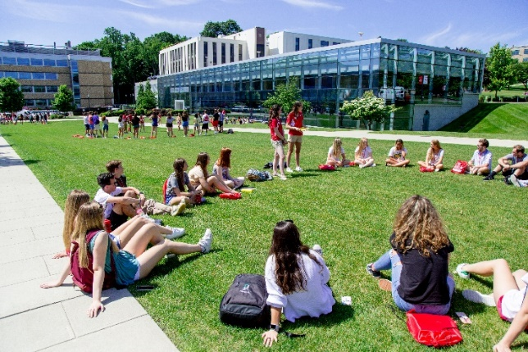
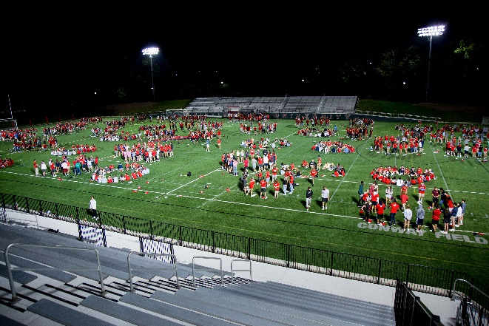
Fall Welcome Engagement
Students will follow schedule based off of their move-in time slot
Socially-distanced in-person and virtual
Informal and formal connection opportunities
Downtime built into schedule
Notes:
Marissa

Slide 25
Fall Welcome Engagement
Schedule includes:
Campus Tours
FYE Group Check-Ins
Floor and Residential Community Building
Campus Scavenger Hunt
Step Up Stags (Bystander Intervention Training)
Late-Night Programming- outdoor movies, take and make crafts, res hall olympics, and more!
First-Year Academic Gathering
Notes:
Marissa

Slide 26
Thank You! Questions? Email Us: orientation@fairfield.edu dosoffice@fairfield.edu studentmove@fairfield.edu
Notes:
Meredith

